Slide 2
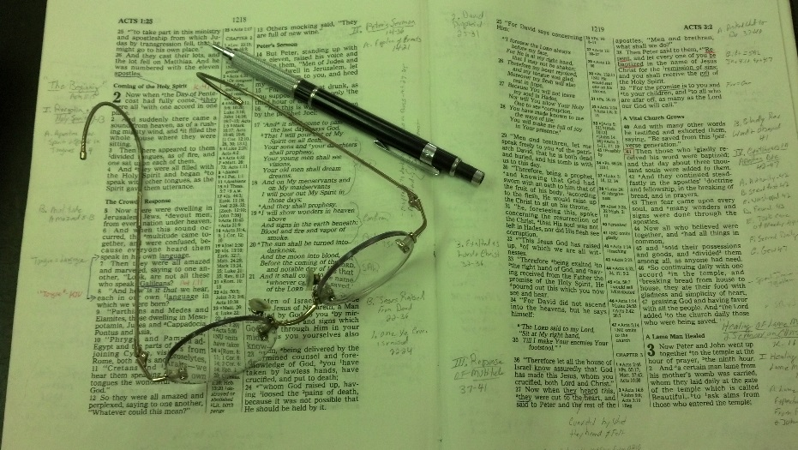
Topics
Friday: Don’t Boast Before the Battle

Slide 3
Joshua 24:15
¹⁴ “Now therefore, fear the Lord, serve Him in sincerity and in truth, and put away the gods which your fathers served on the other side of the River and in Egypt. Serve the Lord!
¹⁵ And if it seems evil to you to serve the Lord, choose for yourselves this day whom you will serve, whether the gods which your fathers served that were on the other side of the River, or the gods of the Amorites, in whose land you dwell. But as for me and my house, we will serve the Lord.”

Slide 4
And if it seems evil to you to serve the Lord,
One would think that no one would deem it “evil” to serve the Lord
Perhaps, one might think it unnecessary – even silly
But, wrong? Evil?
Translations
“but if you don’t want to serve the Lord” (NCV)
“if it is disagreeable in your sight” (NASV)
“but if it doesn’t please you” (Holman)
“but if serving the Lord seems undesirable” (NIV)
“if you are unwilling to serve the Lord” (NRSV)
“but if you refuse to serve the Lord” (NLT)
“and if wrong in your eyes” (YLT)

Slide 5
When it Seems
Evil
to Serve the Lord
Joshua 24:15

Slide 6
When it Seems
Evil to Serve
the Lord
Man Has Reversed the Standard

Slide 7
Man Has Reversed the Standard
Standard is God & His Word
God because he is God – sets the standard (Isa. 55:8-10; Rev. 4:8)
Word has authority (2 Tim. 3:16-17; Tit. 2:15)

Slide 8
Man Has Reversed the Standard
Standard is God & His Word
Man is not at liberty to change the standard
Not to add to or take away (Deut. 4:2; Rev. 2:18-19)
Will be judged by words spoken – not as it is changed (John 12:48)

Slide 9
Man Has Reversed the Standard
Standard is God & His Word
Man is not at liberty to change the standard
Man goes beyond change – to reverse the standard
Call good evil and evil good (Isa. 5:20)
Justify the wicked and condemn just (Prov. 17:15)

Slide 10
Man Has Reversed the Standard
Standard is God & His Word
Man is not at liberty to change the standard
Man goes beyond change – to reverse the standard
Reason man reverses the standard
Leaning on his own wisdom & understanding (Prov. 3:5-6)
Wants to do what he thinks is right (Judges 21:25)
Following what seems right (Prov. 14:12; 16:25)
Deems it evil because it is not what he wants (cf. translations)

Slide 11
When it Seems
Evil to Serve
the Lord
Man Has Reversed the Standard
God’s Grace Says Trust Him

Slide 12
God’s Grace Says Trust Him
Context (vv. 1-13): A Review of the History of God’s Goodness, Grace & Blessings
Call of Abraham (vv. 1-4)
Deliverance from Egypt (vv. 5-7a)
Wilderness wandering (v. 7b)
Conquest to the East (vv. 8-10)
Conquest to the West (vv. 11-13)

Slide 13
God’s Grace Says Trust Him
Context (vv. 1-13): A Review of the History of God’s Goodness, Grace & Blessings
Because of that – serve the Lord (v. 14)
“Now therefore” (v. 14)
Fear the Lord and serve him (v. 14)
How could it be evil in view of what God has done?

Slide 14
God’s Grace Says Trust Him
Context (vv. 1-13): A Review of the History of God’s Goodness, Grace & Blessings
Because of that – serve the Lord (v. 14)
Learn: trust the Lord that he knows what is best
There are going to be requirements of God that challenge our thinking
May even be tempted to say… “that would be wrong…”
Where TRUST comes to play (Psa. 34:8)

Slide 15
When it Seems
Evil to Serve
the Lord
Man Has Reversed the Standard
God’s Grace Says Trust Him
Man Rejects God’s Will

Slide 16
Man Rejects God’s Will
By “reject” – choses his will over God’s
Not that he admits – “this is God’s will & I think it is evil”
But convinces himself – that surely this could not be God’s will

Slide 17
Man Rejects God’s Will
By “reject” – choses his will over God’s
Some things man calls evil
Choosing God over family (Gen. 22; Matt. 10:37)
Capital punishment (Gen. 9:6; Rom. 13:4)
Forgiving one of terrible sin (2 Cor. 2:11)
Spanking a child (Prov. 22:15)
Not forgiving or praying for it (1 John 5:16)
Withdraw & abstain from social (1 Cor. 5; 2 Thess. 3)
Separate from unscriptural marriage (Ezra 10:11)
Unwilling to help one in need (2 Thess. 3:10; 1 Tim. 5:1-ff)
Is there some aspect of God’s will – you think is “evil”?
Is there some requirement – you think, “That can’t be right!”?

Slide 18
When it Seems
Evil to Serve
the Lord
Man Has Reversed the Standard
God’s Grace Says Trust Him
Man Rejects God’s Will
A Decision is Demanded

Slide 19
A Decision is Demanded
Have to choose (v. 15)
If you think it is evil to…. then you have a choice to make
God allows us to choose
God doesn’t force submission
Can make the wrong choice!

Slide 20
A Decision is Demanded
Have to choose (v. 15)
A personal choice (v. 15)
“for yourselves” (v. 15)
No one can make that choice for you – never forced to make right or wrong decision!

Slide 21
A Decision is Demanded
Have to choose (v. 15)
A personal choice (v. 15)
Demands complete submission (v. 19)

Slide 22
When it Seems
Evil to Serve
the Lord
Man Has Reversed the Standard
God’s Grace Says Trust Him
Man Rejects God’s Will
A Decision is Demanded

