Slide 2
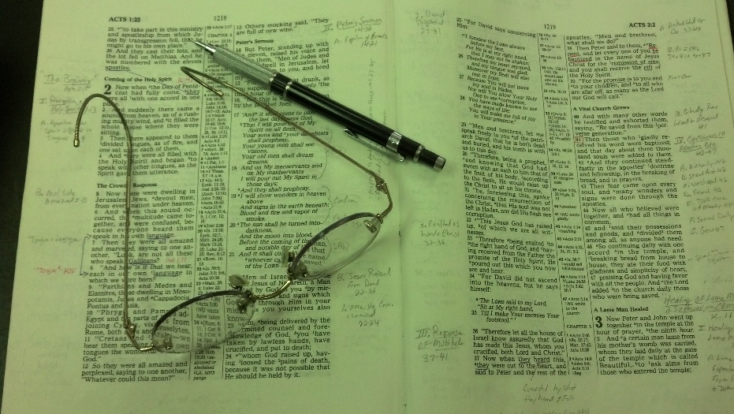
Topics
Tuesday: Nevertheless (Luke 5:1-11)
Wednesday: Strengthening the Hand of the Sinner
Thursday: When it Seems Evil to Serve the Lord
Friday: Don’t Boast Before the Battle

Slide 3
1 Kings 13
Story of two prophets – One old, the other young
In context of kingdom recently dividing (1 Kings 11-12)
Many practical lessons to be learned from these two prophets

Slide 4
1 Kings 13
Message From A Prophet
Prophet speaks against worship by Jeroboam (vv. 1-10) - Warning of the man of God
Cried out against the alter (vv. 1-3)
Jeroboam sought to stop him and witnessed 3 signs (vv. 4-6)
Prophet was invited to king’s house – but could not (vv. 7-10)
Disobedience and death of the prophet (vv. 11-34)
The sin of the man of God (vv. 11-19)
The judgment against the man of God (vv. 20-34)

Slide 5
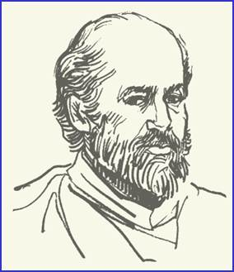
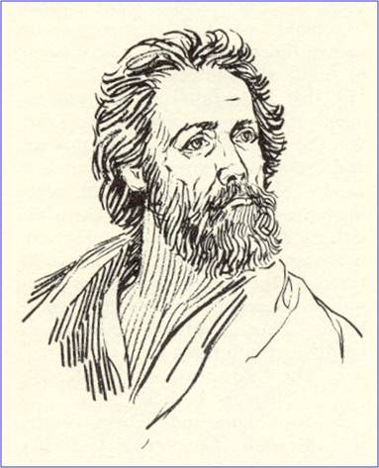
“Alas, My Brother”
The Story of Two Prophets
1 Kings 13

Slide 6
“Alas,
My Brother”
The Story of Two Prophets
Word / Instructions of the Lord are Clear

Slide 7
Word / Instructions of the Lord are Clear
VV. 9, 16-17
Many think the Bible is hard, difficult or “unclear”
Can know and understood
John 8:32
Eph. 3:3-5
Eph. 5:17

Slide 8
Word / Instructions of the Lord are Clear
VV. 9, 16-17
Many think the Bible is hard, difficult or “unclear”
Can know and understood
Doesn’t deny that some things are difficult
There is milk and meat (Heb. 5:12-ff)
Some things are hard (2 Pet. 3:16-ff)
Hard is not same as impossible

Slide 9
Word / Instructions of the Lord are Clear
VV. 9, 16-17
Many think the Bible is hard, difficult or “unclear”
Can know and understood
Doesn’t deny that some things are difficult
The problem in doing what God says – is not in understanding what we are to do
The problem is just doing it
Driven by own will – not yielding (Rom. 10:1-3; Mk. 8:34)

Slide 10
“Alas,
My Brother”
The Story of Two Prophets
Word / Instructions of the Lord are Clear
What the Lord Says is Easy to Do

Slide 11
What the Lord Says is Easy to Do
vv. 9-10
Some think it is really hard to do what is right – stay faithful
Can do what the Lord commands
Otherwise, blame is on God for giving requirement can’t obey!
Commands are not burdensome (1 John 5:3)
Yoke is easy, burden is light (Matt. 11:28)
Commands are “near” – within reach (Rom. 10:6-8)
Not easy when try to follow our will & follow God!

Slide 12
“Alas,
My Brother”
The Story of Two Prophets
Word / Instructions of the Lord are Clear
What the Lord Says is Easy to Do
“Men of God” Can be Wrong

Slide 13
“Men of God” Can be Wrong
vv. 11, 18
Easy to think that a man “in the know” about Bible things – would not mislead
Good student of word
Preacher
Has a degree (masters or PhD)
Professor – written books
Known & heard of him for long time

Slide 14
“Men of God” Can be Wrong
vv. 11, 18
Easy to think that a man “in the know” about Bible things – would not mislead
If he is a man = fallible
Are such people as “false teachers”
Matt. 7:15
2 Pet. 2:1
2 Tim. 4:1
Need to study and compare by the word (Acts 17:11)

Slide 15
“Alas,
My Brother”
The Story of Two Prophets
Word / Instructions of the Lord are Clear
What the Lord Says is Easy to Do
“Men of God” Can be Wrong
Intelligent People Can be Misled

Slide 16
Intelligent People Can be Misled
vv. 9, 18, 19
Young prophet was misled
Not ignorant or lacking in intelligence
In fact, was a prophet – he taught the truth!
Possible for “good” people to be wrong
Must be open minded (i.e. Jews Acts 2)
Paul was a good man, but wrong (Acts 9, 22, 26)
Possible to be deceived (2 Thess. 2:10-12)
When that happens – not a reflection on intelligence

Slide 17
“Alas,
My Brother”
The Story of Two Prophets
Word / Instructions of the Lord are Clear
What the Lord Says is Easy to Do
“Men of God” Can be Wrong
Intelligent People Can be Misled
Makes a Difference What One Believes

Slide 18
Makes a Difference What One Believes
vv. 18-19, 22-24
Common thought: it makes no difference what one believes – as long as sincere / believe in Christ
Made a difference what the young prophet believed & did!
The difference it makes (2 Thess. 2:10-12)
If it makes a difference what one believes:
The questions and issues that divide the religious world are important
Everyone (who believes & teaches differently) can’t be right

Slide 19
“Alas,
My Brother”
The Story of Two Prophets
Word / Instructions of the Lord are Clear
What the Lord Says is Easy to Do
“Men of God” Can be Wrong
Intelligent People Can be Misled
Makes a Difference What One Believes
The Sincere Can be Disobedient

Slide 20
The Sincere Can be Disobedient
vv. 18-19
Young prophet was sincere in what he did – yet still disobedient (vv. 21, 26)
Paul was sincere while opposing Christ (Acts 23:1)
Way that seems right, but is wrong (Prov. 14:12)
Means: possible to be sincerely wrong

Slide 21
“Alas,
My Brother”
The Story of Two Prophets
Word / Instructions of the Lord are Clear
What the Lord Says is Easy to Do
“Men of God” Can be Wrong
Intelligent People Can be Misled
Makes a Difference What One Believes
The Sincere Can be Disobedient

