Slide 2
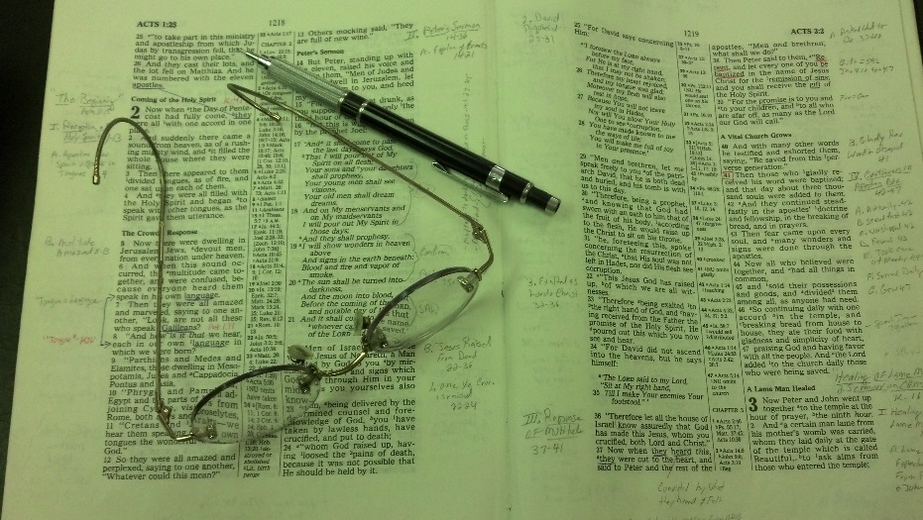
Topics
Thursday: When it Seems Evil to Serve the Lord
Friday: Don’t Boast Before the Battle

Slide 3
Jeremiah 23:14
Also I have seen a horrible thing in the prophets of Jerusalem: They commit adultery and walk in lies; They also strengthen the hands of evildoers, So that no one turns back from his wickedness. All of them are like Sodom to Me, And her inhabitants like Gomorrah.
False Prophets
Ezekiel 13:22
“Because with lies you have made the heart of the righteous sad, whom I have not made sad; and you have strengthened the hands of the wicked, so that he does not turn from his wicked way to save his life.

Slide 4
“Strengthen the Hand”
What does that Mean?
How is it done?
Could I be guilty?
Is it always on purpose?
Could it be done without that being the intent?

Slide 5
Strengthening
the Hand
of the Sinner
Strengthening
the Hand
of the Sinner
Jeremiah 23:14
Ezekiel 13:22

Slide 6
Two Passages Establish the Principle
Strengthening the Hand of the Sinner
Strengthening the Hand of the Sinner

Slide 7
I.
Two Passages Establish the Principle
Meaning of the phrase
  Help – sustain – encourage – give strength to the sinner to continue in sin
  Translations of Jeremiah 23:14
    “encourage evil people to keep on doing evil” (NCV)
    “give encouragement to people who are doing evil” (NET)
    “encourage and strengthen the hand of evildoers” (AMP)

Slide 8
I.
Two Passages Establish the Principle
Meaning of the phrase
  Help – sustain – encourage – give strength to the sinner to continue in sin
  Translations of Jeremiah 23:14
  Translation of Ezekiel 13:22
    “encouraged the wicked” (ESV)
    “encouraged the wicked not to stop being wicked” (NASB, NCV)
    “encouraged the wicked not to turn from their evil way” (NIV)
    “encouraged and strengthened the hands of the wicked” (AMP)

Slide 9
I.
Two Passages Establish the Principle
Meaning of the phrase
  Help – sustain – encourage – give strength to the sinner to continue in sin
  Translations of Jeremiah 23:14
  Translation of Ezekiel 13:22
  Same word (hzq)
    Isa. 35:3 – “strengthen”
    2 Sam. 10:12 – “let us be strong”
    Deut. 3:28 – “encourage”
    Job 8:20 – “uphold” the evildoer
    Lev. 25:35 – “help”
    2 Chron. 28:20 – “assist”

Slide 10
I.
Two Passages Establish the Principle
Meaning of the phrase
Jeremiah 23:14
  Context: Woe to false teachers who lead astray (vv. 9, 13)
  V. 14 – consequence: Wicked do not turn back
  V. 16 – speak of their own mind – not from the Lord
  V. 17 – Say all is well & don’t listen to prophets of doom
  V. 22 – Contrast to what should have been done

Slide 11
I.
Two Passages Establish the Principle
Meaning of the phrase
Jeremiah 23:14
Ezekiel 13:22
  Context: Woe to false prophets
  Vv. 2, 6 – speak of their own heart – not the word of God
  V. 11 – give false hope
  V. 16 – claim peace where is no peace
  V. 22 – consequence: the sinner doesn’t turn back

Slide 12
I.
Two Passages Establish the Principle
Meaning of the phrase
Jeremiah 23:14
Ezekiel 13:22
Principle: Possible to give the sinner strength to continue in sin
Doesn’t mean one has to be a false teacher to “strengthen…”
Doesn’t mean one has to participate or even approve to “strengthen…”

Slide 13
Two Passages Establish the Principle
One Concern We Should Have
Strengthening the Hand of the Sinner
Strengthening the Hand of the Sinner

Slide 14
II.
One Concern We Should Have
Greatest concern for anyone – is salvation of one’s soul
  Worth more than whole world (Matt. 16:26)
  More important than physical well being (Matt. 10:28)
  The whole mission of Christ – save sinners (1 Tim. 1:15)

Slide 15
II.
One Concern We Should Have
Greatest concern for anyone – is salvation of one’s soul
Greatest concern for family – is salvation of their souls
  Should want them to be accepted by God (2 Cor 5:9)
  Wife who loves husband – wants him to be saved (1 Pet. 3:1-2)
  Parents who loves child – wants him / her to be saved (Eph. 6:1-4)
  Siblings who love siblings – want them to be saved (Luke 16:27-28)

Slide 16
II.
One Concern We Should Have
Greatest concern for anyone – is salvation of one’s soul
Greatest concern for family – is salvation of their souls
If greatest concern – is salvation of soul
Then why
Do anything that would strengthen hand in sin?

Slide 17
Two Passages Establish the Principle
One Concern We Should Have
Multiple Ways We Could Be Guilty
Strengthening the Hand of the Sinner
Strengthening the Hand of the Sinner

Slide 18
III.
Multiple Ways We Could Be Guilty
When we give our opinion – not based upon Scripture (Jer. 23:16; Ezek. 12:2, 6)
When we tell family member he / she is okay – when not (Jer. 23:17; Ezek. 13:26)
When we tell family member not to listen to “the prophets of doom” (Jer. 23:17)
When we tell family or friend “God wants you to be happy”
When we enable them (cf. Luke 15:16)
  By giving to them
  By bailing them out
  By ignoring life of sin – focus on relationship

Slide 19
III.
Multiple Ways We Could Be Guilty
When we go along with what we know to be wrong (1 Cor. 5; Gal. 2:13-ff)
When we protect loved ones from those who seek to encourage or correct them
When we dismiss strict teaching without study or refutation
When we help them get /do what they want regardless of the wisdom (1 Kings 21)
When we make excuses for family who are not living as should
When we fail to teach, correct (Eph. 5:11)

Slide 20
Strengthening
the Hand
of the Sinner
Strengthening
the Hand
of the Sinner
Jeremiah 23:14
Ezekiel 13:22

Slide 21
Two Passages Establish the Principle
One Concern We Should Have
Multiple Ways We Could Be Guilty
Strengthening the Hand of the Sinner
Strengthening the Hand of the Sinner

