Slide 2
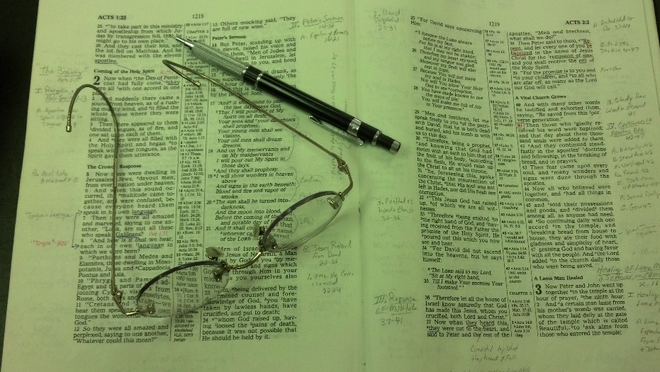
Topics
Monday: Alas, My Brother (Story of Two Prophets)
Tuesday: Nevertheless (Luke 5:1-11)
Wednesday: Strengthening the Hand of the Sinner
Thursday: When it Seems Evil to Serve the Lord
Friday: Don’t Boast Before the Battle

Slide 3

What Do You Have That You Are Willing to Sell?
Better: Not Willing to Sell?
Some say, “Not for sale at any price!”
Truth: We would sell most anything at right price!
Likely – would sell some very dear possessions

Slide 4
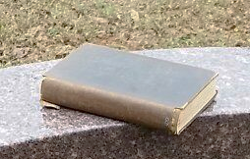
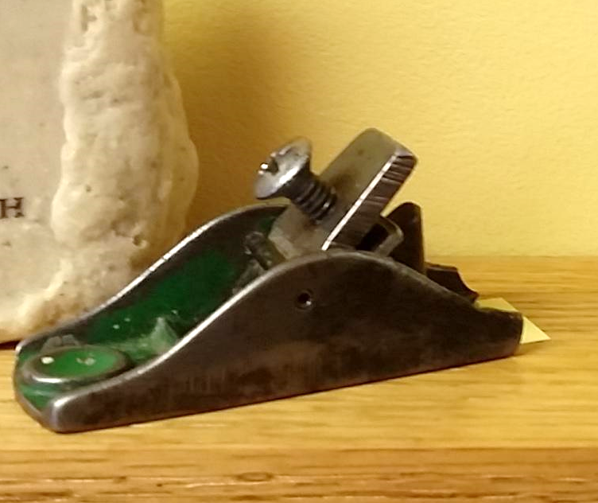
Market Value: $3 – $5
$500
Market Value: $3 – $5
$500

Slide 5
What Do You Have That You Are Willing to Sell?
Better: Not Willing to Sell?
Some say, “Not for sale at any price!”
Truth: We would sell most anything at right price!
Likely – would sell some very dear possessions
Especially true – if someone encouraging you to sell!

Slide 6

Would You Sell
Yourself?
Not in an immoral way!
Would you sell out your principles?
Would you sell yourself to someone else – slave?

Slide 7
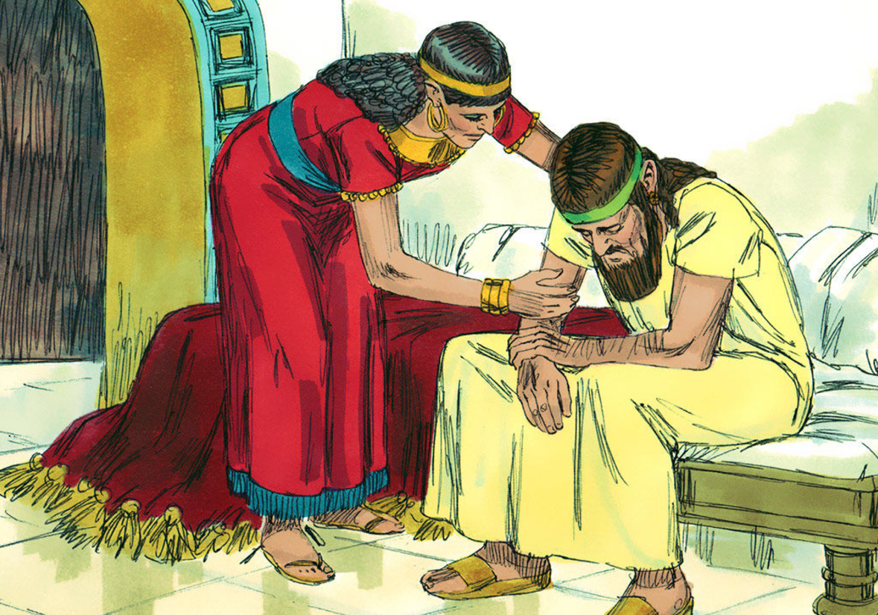
King Ahab
Sold Himself
Introduced to Ahab (1 Kings 16:29-30)
His story recorded (1 Kings 16:29 – 1 Kings 22)
He sold himself to do wickedness (1 Kings 21:25)

Slide 8
1 Kings 21:25
But there was no one like Ahab who sold himself to do wickedness in the sight of the Lord, because Jezebel his wife stirred him up.

Slide 9
1 Kings 21:25
But there was no one like Ahab who sold himself to do wickedness in the sight of the Lord, because Jezebel his wife stirred him up.
1
2

Slide 10
Selling & Stirring
1 Kings 21:25

Slide 11
Selling & Stirring
Ahab Sold Himself to Do Evil
  (1 Kings 21:20, 25)
Jezebel Stirred Him Up
  (1 Kings 21:25)
1 Kings 21:25

Slide 12
Selling & Stirring
Ahab Sold Himself to Do Evil
  (1 Kings 21:20, 25)
A Metaphor:
Practice of selling oneself into slavery
(2 Kings 17:17; Rom. 7:14)
1 Kings 21:25

Slide 13
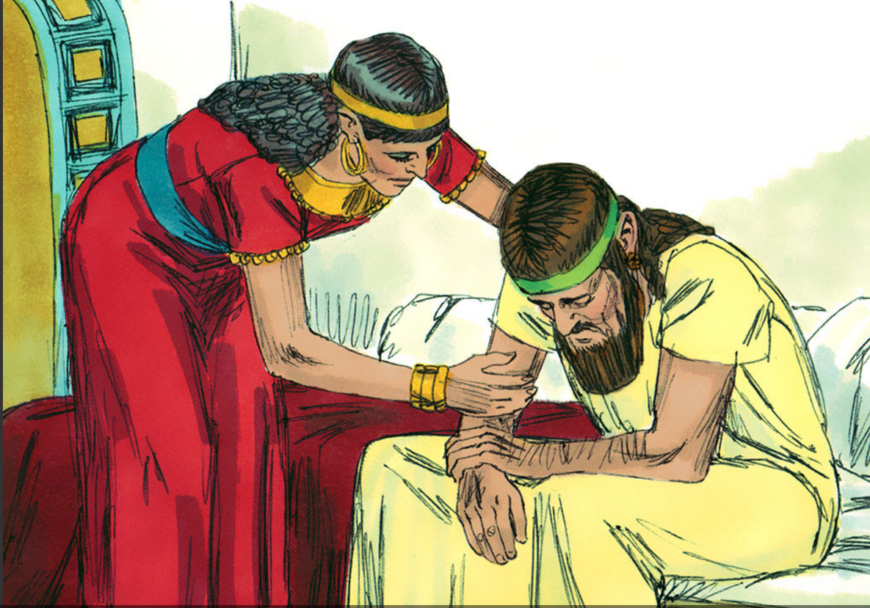
Ahab Sold Himself to Do Evil
  (1 Kings 21:20, 25)
Viewed Sin as Trivial (1 Kings 16:31)
  No serious consequences (John 8:21)
  No reason for shame (Ezek. 16:52)
  Laugh at those who say it is bad – serious
  Selling yourself when treat sin as trivial!

Slide 14
Ahab Sold Himself to Do Evil
  (1 Kings 21:20, 25)
Viewed Sin as Trivial (1 Kings 16:31)
Married a Worldly Woman (1 Kings 16:31)
  Jezebel was a Pagan – idol worshipper
  Jews were forbidden to marry Pagans (Exo. 34:15-16; Deut. 7:3-4)
  She brought her worldly influence into the marriage
  Selling yourself when you marry a worldly person!

Slide 15
Ahab Sold Himself to Do Evil
  (1 Kings 21:20, 25)
Viewed Sin as Trivial (1 Kings 16:31)
Married a Worldly Woman (1 Kings 16:31)
Took on a Religion Like the World (1 Kings 16:31-33)
  World worshipped idols
  Took on their religious practices
  No different than world
  Selling yourself when your religion is not that much different than the world

Slide 16
Ahab Sold Himself to Do Evil
  (1 Kings 21:20, 25)
Viewed Sin as Trivial (1 Kings 16:31)
Married a Worldly Woman (1 Kings 16:31)
Took on a Religion Like the World (1 Kings 16:31-33)
Blamed Others for His Own Problems (1 Kings 18:17)
  He was the one leading others into idolatry – Thus, he was the one troubling Israel!
  Elijah was merely telling the truth – God’s word
  Blames Elijah for the trouble in Israel
  Selling yourself when you blame others
    When you make bad choices – blame those who correct you
    When the fruits of your choices are evident – blame others

Slide 17
Ahab Sold Himself to Do Evil
  (1 Kings 21:20, 25)
Viewed Sin as Trivial (1 Kings 16:31)
Married a Worldly Woman (1 Kings 16:31)
Took on a Religion Like the World (1 Kings 16:31-33)
Blamed Others for His Own Problems (1 Kings 18:17)
Did What He Wanted – Instead (1 Kings 20:35-43)
  God said he would deliver Ben-Hadad (20:28)
  God wanted him destroyed (20:42)
  Ahab was given illustrations of disobed. (20:35-41)
  When you do what you want regardless of God’s will – selling yourself!

Slide 18
Ahab Sold Himself to Do Evil
  (1 Kings 21:20, 25)
Viewed Sin as Trivial (1 Kings 16:31)
Married a Worldly Woman (1 Kings 16:31)
Took on a Religion Like the World (1 Kings 16:31-33)
Blamed Others for His Own Problems (1 Kings 18:17)
Did What He Wanted – Instead (1 Kings 20:35-43)
Selfish & Discontent (1 Kings 21:1-16)
  Wanted Naboth’s vineyard (21:1-4)
  Pouted – acted childish (21:4)
  He was king – had an abundance – could have bought another vineyard!
  Willing to go to any length (21:5-16)
  When you are discontent & selfish – selling yourself

Slide 19
Ahab Sold Himself to Do Evil
  (1 Kings 21:20, 25)
Viewed Sin as Trivial (1 Kings 16:31)
Married a Worldly Woman (1 Kings 16:31)
Took on a Religion Like the World (1 Kings 16:31-33)
Blamed Others for His Own Problems (1 Kings 18:17)
Did What He Wanted – Instead (1 Kings 20:35-43)
Selfish & Discontent (1 Kings 21:1-16)
Disregard for Those Who Proclaim Truth (1 Kings 22:8)
  Micaiah (prophet) told truth about Ahab (22:14)
  Ahab hated him because he didn’t say what he wanted
  When you reach the point – dislike /disregard for those stand for truth – selling yourself!

Slide 20
Ahab Sold Himself to Do Evil
  (1 Kings 21:20, 25)
Viewed Sin as Trivial (1 Kings 16:31)
Married a Worldly Woman (1 Kings 16:31)
Took on a Religion Like the World (1 Kings 16:31-33)
Blamed Others for His Own Problems (1 Kings 18:17)
Did What He Wanted – Instead (1 Kings 20:35-43)
Selfish & Discontent (1 Kings 21:1-16)
Disregard for Those Who Proclaim Truth (1 Kings 22:8)

Slide 21
Could You Be Selling Yourself To Do Evil?
Selling out your principles?
Compromises?
Turned your back on what you know to be right?

Slide 22
Selling & Stirring
Ahab Sold Himself to Do Evil
  (1 Kings 21:20, 25)
Jezebel Stirred Him Up
  (1 Kings 21:25)
1 Kings 21:25

Slide 23
1 Kings 21:25
But there was no one like Ahab who sold himself to do wickedness in the sight of the Lord, because Jezebel his wife stirred him up.
1
2

Slide 24
Jezebel Stirred Him Up
  (1 Kings 21:25)
Brought Influence of World (1 Kings 16:30-31)
  Marriage is closest of relationships – natural that she would have strong influence!
  The Pagans influenced Israel (Psa. 106:34-37)
  Solomon’s wives influenced him (Neh. 13:25-26)
  It may be that the influence of a worldly mate or friend is stirring you up!

Slide 25
Jezebel Stirred Him Up
  (1 Kings 21:25)
Brought Influence of World (1 Kings 16:30-31)
Destroyed the Influence of Godly Leaders (1 Kings 18:4, 13; 19:2)
  Sought to silence those against wickedness
  Those who begin to veer from the path – do not appreciate godly leaders
Parents When You:
Allow the influence of the world
Minimize the influence of elders, preachers, and brethren
You Are Stirring Your Children Up!

Slide 26
Jezebel Stirred Him Up
  (1 Kings 21:25)
Brought Influence of World (1 Kings 16:30-31)
Destroyed the Influence of Godly Leaders (1 Kings 18:4, 13; 19:2)
Helped Ahab Get What He Wanted (1 Kings 21:5-16)
  There was no telling him – can’t have it!
  Attitude was: “Whatever it takes…”
  Helped – aided – planned – how he could do what he wanted.
  When you help, coach, encourage your family to get what they want – regardless of wisdom – stirring them up!

Slide 27
Jezebel Stirred Him Up
  (1 Kings 21:25)
Brought Influence of World (1 Kings 16:30-31)
Destroyed the Influence of Godly Leaders (1 Kings 18:4, 13; 19:2)
Helped Ahab Get What He Wanted (1 Kings 21:5-16)
Little Regard for Things of Value (1 Kings 21:1-16)
  No regard for property of others
  No regard for principles of fairness
  No regard for human life
  When are around those who have little regard for important things – being stirred up!
  When you are not emphasizing what is important to your mate – children – stirring them up!

Slide 28
Jezebel Stirred Him Up
  (1 Kings 21:25)
Brought Influence of World (1 Kings 16:30-31)
Destroyed the Influence of Godly Leaders (1 Kings 18:4, 13; 19:2)
Helped Ahab Get What He Wanted (1 Kings 21:5-16)
Little Regard for Things of Value (1 Kings 21:1-16)

Slide 29

Could Someone Be
Stirring You Up?
Could You Be Stirring
Someone up?
Feed off of other’s fears?
Feed off of other’s dislikes?
Encourage another, “Not the only one that feels that way…”
Plant seeds / doubts / ideas … then build on them?

Slide 30
Selling & Stirring
Ahab Sold Himself to Do Evil
  (1 Kings 21:20, 25)
Jezebel Stirred Him Up
  (1 Kings 21:25)
1 Kings 21:25

