Slide 2
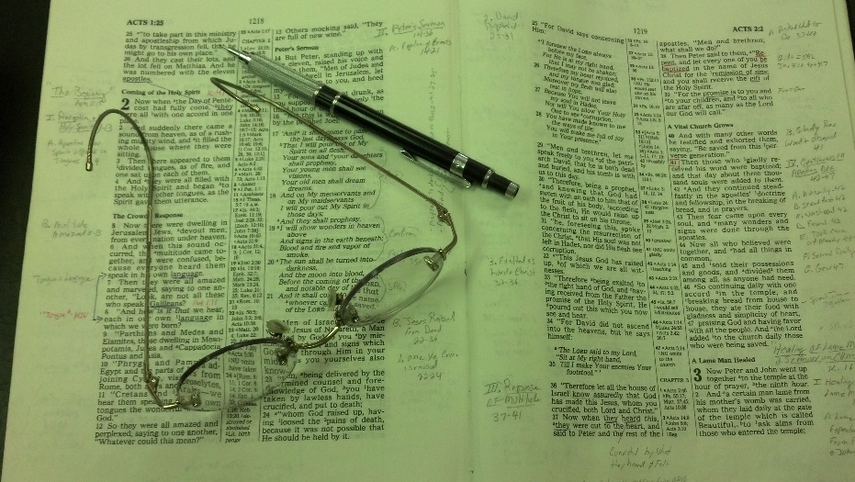
Topics
Wednesday: Strengthening the Hand of the Sinner
Thursday: When it Seems Evil to Serve the Lord
Friday: Don’t Boast Before the Battle

Slide 3
Call of the First Disciples
Setting: Lake of Gennesaret (Sea of Galilee)
Luke 5:1-11

Slide 4
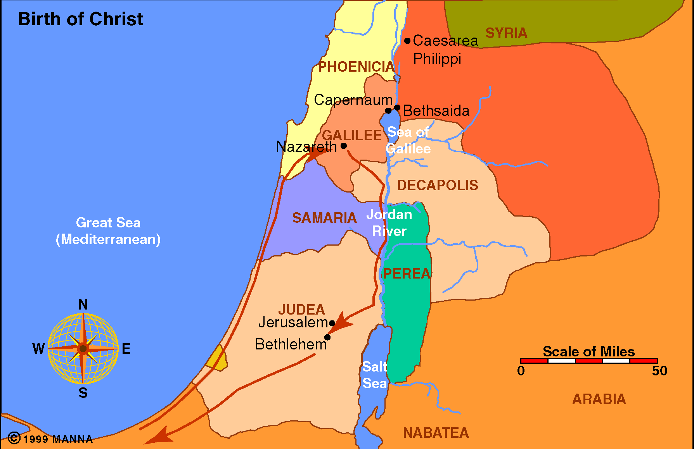
Christ’s Birth

Slide 5
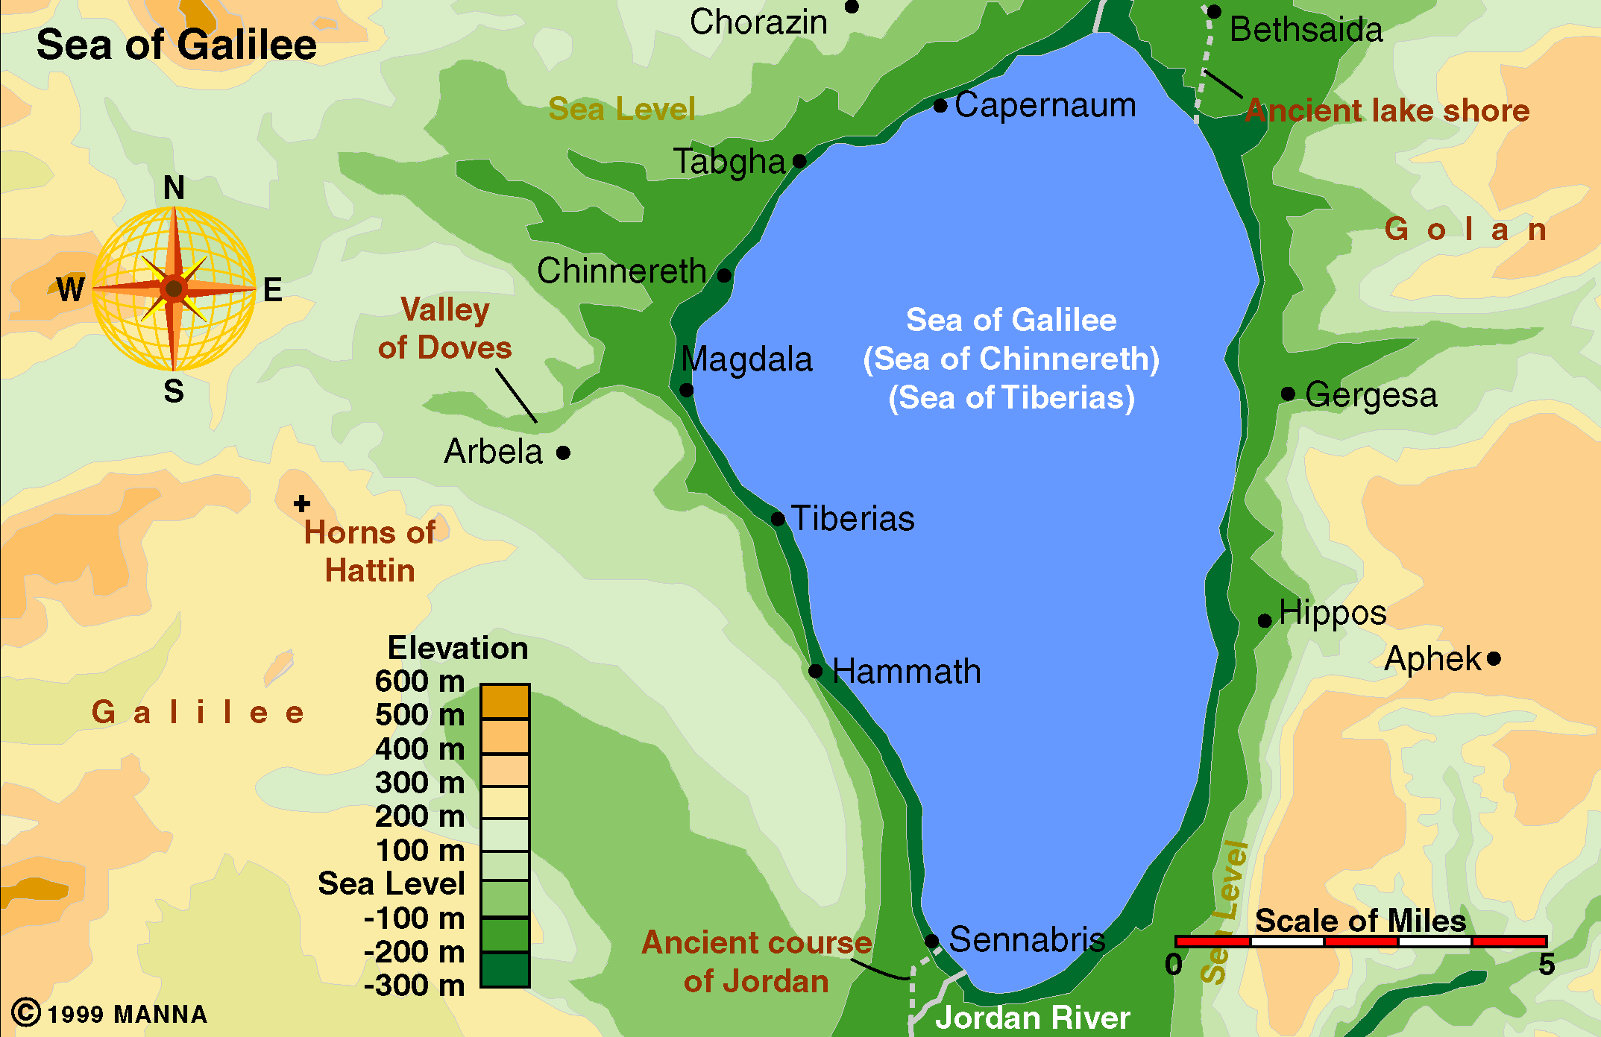
Sea of Galilee
Land to south of Capernaum on western side often call Gennesaret
The lake itself call Sea of Tiberias

Slide 6
Call of the First Disciples
Setting: Lake of Gennesaret (Sea of Galilee)
As crowd presses – he enters a boat to teach (v. 3)
Peter & fishing partners – washing nets after an unsuccessful night (v. 2)
Tells Peter to launch into deep & cast net (v. 4)
Peter does so – even though – hadn’t worked all night (v. 5)
Luke 5:1-11

Slide 7
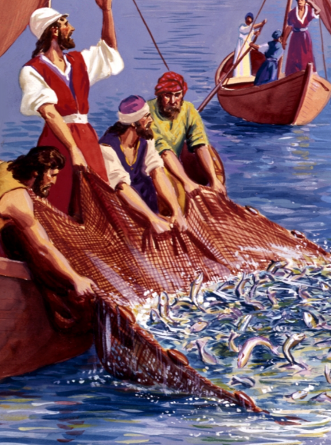
Amazing Results!
Great number of fish
Filled net – began to break
Filled two boats – both began to sink

Slide 8
Call of the First Disciples
Setting: Lake of Gennesaret (Sea of Galilee)
As crowd presses – he enters a boat to teach (v. 3)
Peter & fishing partners – washing nets after an unsuccessful night (v. 2)
Tells Peter to launch into deep & cast net (v. 4)
Peter does so – even though – hadn’t worked all night (v. 5)
Peter reacts with deep humility (vv.8-9)
Disciples forsook all and followed (vv. 10-11)
Luke 5:1-11

Slide 9
Luke 5:4–5 (NKJV)
⁴ When He had stopped speaking, He said to Simon, “Launch out into the deep and let down your nets for a catch.”
⁵ But Simon answered and said to Him, “Master, we have toiled all night and caught nothing; nevertheless at Your word I will let down the net.”

Slide 10
Fished all night (v. 5)
Caught nothing (v. 5)
Washing nets (v. 2)
Launch out (v. 4)
Cast nets (v. 4)
At thy word (v. 4)
Nevertheless
Contrast
But (ASV, ESV)
In Spite of

Slide 11
Nevertheless
Obey – Even if Seems Unreasonable
Lessons in Discipleship
Luke 5:1-11

Slide 12
Request of Jesus seemed unreasonable
  Fished all night – caught nothing
  They are professional fishermen – what does a carpenter know?
  This was early in process of calling his disciples – yet Peter has seen enough to have a strong faith!
Obey
Even If Seems
Unreasonable

Slide 13
Request of Jesus seemed unreasonable
It is not our place to question & doubt
  Jer. 10:23
  Isa. 55:8-9
  Prov. 16:25
  Rom. 11:34
  It is ours to believe and do
    He is creator – we are creatures
    He is God – we are men
    He is Lord – we are his servants
Obey
Even If Seems
Unreasonable

Slide 14
Request of Jesus seemed unreasonable
It is not our place to question & doubt
Bible characters were asked to do what seems unreasonable
  Believe would have a son in old age (Rom. 4:17-ff)
  Sacrifice son (Gen. 22)
  Separate from wives (Ezra 10)
  Dip seven times (2 Kings 5)
Obey
Even If Seems
Unreasonable

Slide 15
Request of Jesus seemed unreasonable
It is not our place to question & doubt
Bible characters were asked to do what seems unreasonable
God asks us to do what seems unreasonable
  Baptized (Mark 16:16)
  Divorce for only one cause (Matt. 19:9)
  Not forsake under distress (Heb. 10:25)
  Withdraw from disorderly (2 Thess. 3)
  Forgive if repent (Luke 17:1-5)
Obey
Even If Seems
Unreasonable

Slide 16
Nevertheless
Obey – Even if Seems Unreasonable
Try – Even if Seems Impossible
Lessons in Discipleship
Luke 5:1-11

Slide 17
Peter must have thought about failure
  Fished all night – caught nothing
  “Nevertheless” suggests he was going to act CONTRARY to how things look
  He acts solely on faith in Jesus!
  Going to try – in spite of:
    Failure of the night
    Possible failure of the future
  By trying he caught fish – would not have happened otherwise!
  If he had not TRIED – he would have failed (as fisherman & disciple)
Try
Even If Seems
Impossible

Slide 18
Peter must have thought about failure
We must try to do what we are afraid we will fail in
  Living the Christian life
  Bringing others to Christ
  Correct & restrain children
  Teaching effort (radio, bulletin, etc.)
  Teaching a class / taking part in service
  Forgiving
  Try to be mate should be
Try
Even If Seems
Impossible

Slide 19
Peter must have thought about failure
We must try to do what we are afraid we will fail in
One talent man failed saying, “I was afraid” (Matt. 25:25)
Try
Even If Seems
Impossible

Slide 20
Nevertheless
Obey – Even if Seems Unreasonable
Try – Even if Seems Impossible
Continue On – Even if Weary
Lessons in Discipleship
Luke 5:1-11

Slide 21
Peter & other fishermen were tired
  Toiled all night (v. 5)
  Things had not gone as hoped
  Disappointed – discouraged
  Seems like all done was useless
  If ever thought of quitting – this is the time!
  Yet – Jesus said keep fishing!
Continue
On
Even If Weary

Slide 22
Peter & other fishermen were tired
Easy to become weary - discouraged
  Life doesn’t go as planned
  Face unexpected difficulties
  Try & seems get knocked down!
  May be weary with self – lack of progress
  May be weary with family – lack of cooperation – faithfulness, etc.
  May be weary with those try influence – no fruit
Continue
On
Even If Weary

Slide 23
Peter & other fishermen were tired
Easy to become weary – discouraged
The weary, tired and discouraged must continue on
  Point of Hebrews 10-13
    10:23, 35, 36, 39
    12:1, 12
  1 Cor. 15:58
  Gal. 6:7-9
  Don’t ever quit – launch back out into the deep!
Continue
On
Even If Weary

Slide 24
Nevertheless
Obey – Even if Seems Unreasonable
Try – Even if Seems Impossible
Continue On – Even if Weary
Humble – Even if it is Hard
Lessons in Discipleship
Luke 5:1-11

Slide 25
Humility may not have been real easy for Peter
  Disciples argued about who is the greatest (Matt. 18:1-ff)
  Confidence in himself – always seems to first to speak or answer (i.e. Mt. 26:31-33)
  Confidence to act – cut off Malchus’ ear (Jno. 18:10)
  Claimed he would never stumble or deny Christ (Matt. 26:31-33)
Humble
Even If it
is Hard

Slide 26
Humility may not have been real easy for Peter
Peter humbly bowed before Jesus
  Reason: astonished at his power (v. 9)
  Reaction: Conscience of his own unworthiness to be in his presence (v. 8)
  Peter had seen other miracles (cf. Luke 4), but this was a turning point!
  Jesus sought to calm his fears (v. 10) – fear /anxiety must turn to love and respect
Humble
Even If it
is Hard

Slide 27
Humility may not have been real easy for Peter
Peter humbly bowed before Jesus
God calls us to be humble
  Call to be humble (Matt. 18:3-4; 1 Pet. 5:5-6)
  Times it may be hard
    When think better (Luke 18:9-14)
    When think valuable (Matt. 18:1-4)
    When think stronger (Gal. 6:1-3)
    When think know more (1 Cor. 8:1-2)
Humble
Even If it
is Hard

Slide 28
Nevertheless
Obey – Even if Seems Unreasonable
Try – Even if Seems Impossible
Continue On – Even if Weary
Humble – Even if it is Hard
Forsake All – Even if it is Important
Lessons in Discipleship
Luke 5:1-11

Slide 29
Jesus called upon them to be disciples which demanded them to forsake….
  Left business & boats
    Wasn’t much – but all had!
    When they had best day ever!
  Left family (Matt. 4:22; Mark 1:20)
  Left ALL!
  Reason: Who they followed, what they became & what doing far exceeded…
  Forsaking / Leaving was immediate – not days later!
Forsake
All
Even If it is Important

Slide 30
Jesus called upon them to be disciples which demanded them to forsake….
Discipleship demands we forsake all
  Lord should always come first
    Matt. 6:33
    1 Pet. 3:15
    Matt. 19:16-31
Forsake
All
Even If it is Important

Slide 31
Jesus called upon them to be disciples which demanded them to forsake….
Discipleship demands we forsake all
  Lord should always come first
  Means: may cost you:
    Money
    Job
    Friends
    Relationships
    Family
    Time
Forsake
All
Even If it is Important

Slide 32
Jesus called upon them to be disciples which demanded them to forsake….
Discipleship demands we forsake all
  Lord should always come first
  Means: may cost you:
  If not willing to forsake it all – not fit for the kingdom (Lk. 9:62)
Forsake
All
Even If it is Important

Slide 33
Nevertheless
Obey – Even if Seems Unreasonable
Try – Even if Seems Impossible
Continue On – Even if Weary
Humble – Even if it is Hard
Forsake All – Even if it is Important
Lessons in Discipleship
Luke 5:1-11

