Slide 2
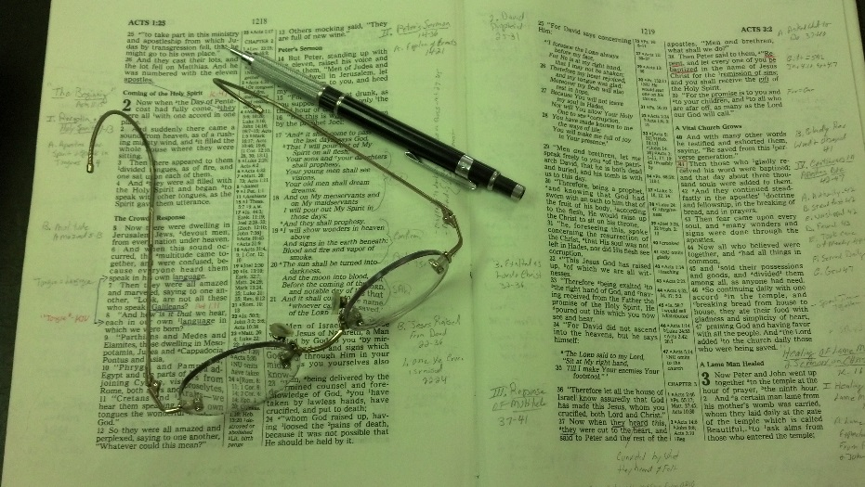
Topics
Sunday PM: Selling and Stirring
Monday: Alas, My Brother (Story of Two Prophets)
Tuesday: Nevertheless (Luke 5:1-11)
Wednesday: Strengthening the Hand of the Sinner
Thursday: When it Seems Evil to Serve the Lord
Friday: Don’t Boast Before the Battle

Slide 3
Peter is a disciple with whom many Christians can identify –
Zeal
Boldness
Overconfident
Yet, he often got in his own way

Slide 4
Peter boldly proclaimed devotion (Matt. 26:31-35)
Yet when Jesus was arrested – he followed at a distance
Matt. 26:58
Mark 14:54
Luke 22:54-55
John 18:15-16

Slide 5
Following at a Distance is just as much a danger for us as it was for Peter.
Following
at a
Distance

Slide 6
Following at a Distance
The Reasons
The Dangers
The Signs
The Justification

Slide 7
Following at a Distance
The Reasons

Slide 8
The Reasons
Fear of a close connection
For Peter:
Jesus was arrested (Mt. 26:57) – he might be too!
Jesus was on trail (Mt. 26:57) – he could be too!
Wanted to kill Jesus (Mt. 26:59) – might kill him too!
For Us:
Expected to be involved
Expected to give up (practice, relationship, etc.)
Held to a higher standard – expected to follow it

Slide 9
The Reasons
Fear of a close connection
Deceived self into thinking still following
Following – but don’t want to be too close
Following – but don’t want to be too involved
Was with John, but didn’t go as far (John 18:15-16)
Don’t really think of self as “at a distance”

Slide 10
The Reasons
Fear of a close connection
Deceived self into thinking still following
Ignored the warnings
Was told that his faith would fail (Luke 22:31-34)
Was warned that he would deny the Lord (Mt. 26:31-35)
When cock sounded the 1st time – should have shook him (Mark 14:68-72)
Bowed his neck – denied again & again
Finally it hit him on second crow (v. 72), but it was too late!

Slide 11
The Reasons
Fear of a close connection
Deceived self into thinking still following
Ignored the warnings
Forgot the commitment
Commitment was demanded of disciples (Matt. 16:24)
Peter had boldly proclaimed his commitment to Jesus (Matt. 26:32-35)
For the moment – he forgot all about it
We make a commitment when we obey the gospel
Rom. 6:17-18
Luke 6:46

Slide 12
Following at a Distance
The Reasons
The Dangers

Slide 13
The Dangers
Leads to other sins
Lying (Matt 26:70)
Denial of the Lord (Matt. 26:70, 72, 74)
Faith failed (Luke 22:32)
Not surprising when one follows at a distance:
Involved in worldliness
Do things they know to be wrong
Language is not becoming
Attitude turn sour
Likewise – not surprising – there is much they don’t know!

Slide 14
The Dangers
Leads to other sins
Easy to go even further
Peter moved further away (Matt. 26:71; Mk. 14:68)
At a distance – makes it easy to put a wider gap between
Easy to lose faith altogether
Heb. 3:12
Heb. 6:4-8
Heb. 10:26-ff
Reach the point of no return

Slide 15
Following at a Distance
The Reasons
The Dangers
The Signs

Slide 16
The Signs
Warm yourself by the devil’s fire
Peter warmed himself by the fire (Mk. 14:54; Lk. 22:55)
Continued association (Lk. 22:59)
This was no brief association
Not bothered to be among the enemies
Lot pitch his tent toward Sodom (Gen. 13:12)
When you are among / around a world of sin – you are following at a distance!

Slide 17
The Signs
Warm yourself by the devil’s fire
Rather be comfortable with the world than uncomfortable with the Lord
Peter warmed himself by enemy’s fire (John 18:18)
To identify with the Lord would have been uncomfortable
It was cold – sought to be comfortable with the enemies
When we are just as close (or closer) to the world – than brethren – we are following at a distance!

Slide 18
The Signs
Warm yourself by the devil’s fire
Rather be comfortable with the world than uncomfortable with the Lord
Careless attitude
Peter sat among the enemies – not bothered
Denial once – then twice – and sits among the enemies – not bothered!
As if saying, “I’m Ok. I am not affected. I can handle this. No big deal!”

Slide 19
Following at a Distance
The Reasons
The Dangers
The Signs
The Justification

Slide 20
The Justification
Reason Peter gave – “to see end” (Mt. 26:58)
To see the “outcome” (NASB; NIV)
Should have known – Jesus had told him (Matt. 16:21)
Lenski: “We always invent good reasons for doing what we ought not to do” (Matthew, 1057).
He wanted to know without being a part

Slide 21
The Justification
Reason Peter gave – to see end (Mt. 26:58)
Often we are more spectators than disciples
Justification for following at distance: we want to know a little of what is going on
Following out of curiosity more than our conscience

Slide 22
“He followed him, but it was only to see the end, led more by his curiosity than by his conscience; he attended as an idle spectator rather than as a disciple, a person concerned. … Note, It is more our concern to prepare for the end, whatever it may be, than curiously to enquire what the end will be. The event is God’s, but the duty is ours.”
Henry, M. (1994). Matthew Henrys commentary on the whole Bible: complete and unabridged in one volume (p. 1760)

Slide 23
Following at a Distance
The Reasons
The Dangers
The Signs
The Justification

