Slide 2
Bearing The Burdens Of Life
Gal. 6:2
Gal. 6:5
The Burden Of Marriage
And Parenting!

Slide 3

The Burden Of Marriage
“For I wish that all men were even as I myself.”
I Corinthians 7:7a

Slide 4
Who To Marry?

Slide 5
The Burden Of Marriage
Are they qualified?
What is he/she really like?
Religious Issues!
Where do we live?
The parents!
Employment!
Money issues!
Sex issues!
Activities!
CHILDREN!
The burden of failing!
Becoming a caretaker!

Slide 6
The Burden Of Marriage
In a changing world,
Eternal principles never change.
Genesis 2:24-25
I Corinthians 7:1-2

Slide 7

Enjoy The Honeymoon!
For Better
For Worse
The Reality Of Marriage Awaits!

Slide 8
Malachi 2:16
The Burden Of Making It Work!
I Cor. 7:1-2
Hebrews 13:4
Ecclesiastes 9:9
Ephesians 5:33

Slide 9
The Burden Of Loving Her
As She Wants
Closeness - She wants you to be close
Openness – She wants you to be open
Understanding – Don’t try to ‘fix’ her; LISTEN
Peacemaking – She wants you to say “I’m sorry”
Loyalty – She needs to know you’re committed
Esteem – She wants you to honor and cherish her

Slide 10
The Burden Of Giving Him The Respect He Desires
Conquest - Appreciate his desire to work & achieve
Hierarchy – Appreciate his desire to protect & provide
Authority – Appreciate his desire to serve & lead
Insight – Appreciate his desire to analyze & counsel
Relationship – Appreciate his desire for ‘shoulder to shoulder’ relationship
Sexuality – Appreciate his desire for sexual intimacy

Slide 11
The Burden Of
Unconditional Love
The Crazy Cycle -
  Without love she reacts
  Without respect he reacts
The Energizing Cycle –
  His love motivates
  Her respect motivates
The Rewarded Cycle –
  Regardless of his love
  Regardless of her respect
Eph. 5:33

Slide 12
The Burden On The Husband
Praise his wife – Prov. 31:28-29
Be content with the wife of his youth – Prov. 5:15-21
Love your wife as Christ loved the church – Eph. 5:25
Do not be bitter toward your wife – Col. 3:19
Eph. 5:23

Slide 13
The Burden On The Wife
Trustworthy – Prov. 31:11
Have an enduring love – Prov. 31:12
Develop an inner person – Prov. 31:25
Speak wisdom & kindness – Prov. 31:26
Not be contentious – Prov. 21:9, 19

Slide 14
The Burden Of Reputation
Guard their name & reputation – Prov. 22:1
Be accountable to one another – Prov. 12:15; 27:17
Practice forgiveness – Prov. 17:9
Practice honesty – Prov. 21:2-3

Slide 15
The Burden Of Reputation
Practice reverence – Prov. 14:26; 16:3
Practice contentment – Prov. 15:16; 16:8
Practice respect – Prov. 16:31; 23:22
Communicate – Prov. 25:11

Slide 16
Bearing The Burdens Of Life
The Blessings of Children
The Burden Of Marriage

Slide 17
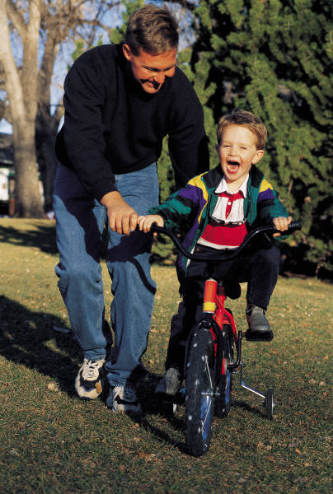
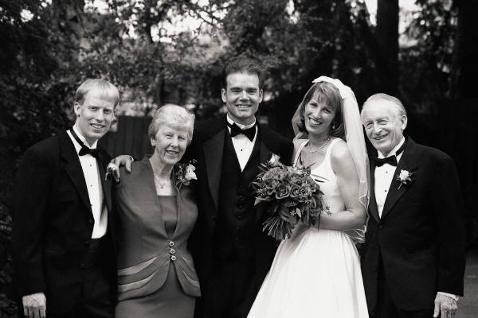

"One father is more than a hundred school masters."
English Proverb
"It is a wise father that knows his own child."
Shakespeare

Slide 18
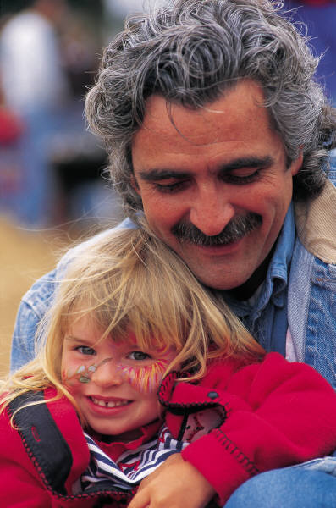
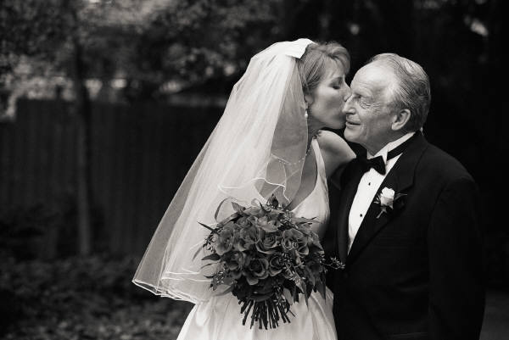
"A father is always making
his baby into a little woman.
And when she is a woman
he turns her back again!"
Enid Bagnold

Slide 19


“I watched a small man with thick calluses on both hands work fifteen and sixteen hours a day. I saw him once literally bleed from the bottoms of his feet, a man who came here uneducated, alone, unable to speak the language, who taught me all I needed to know about faith and hard work by simple eloquence of his example.”
Mario Cuomo

Slide 20

What kind of
father will
I be?
Eph. 6:4

Slide 21
I Chronicles 28:9
“As for you, my son Solomon know the God of your father, and serve Him with a loyal heart and with a willing mind; for the Lord searches all hearts and understands the intent of the thoughts. If you seek Him, He will be found by you but if you forsake Him, He will cast you off forever.”
A Verse To Remember For Godly Fathers

Slide 22
Godly Fathers Teach Their Children:
To Know God --- I Chronicles 28:9
Nothing more important in life --- Jeremiah 9:23-24
Displeasing to God not to know Him --- Judges 2:10; Hosea 4:1, 6; Romans 1:18-28

Slide 23
Godly Fathers Teach Their Children:
To Serve God --- I Chronicles 28:9
With a loyal heart
With wholehearted devotion
It is our way to show we understand the greatest commandment--- Matthew 22:36-38

Slide 24
Godly Fathers Teach Their Children:
To Seek God --- I Chronicles 28:9
Matthew 6:33
This is the whole duty of man --- Eccl. 12:13-14

Slide 25

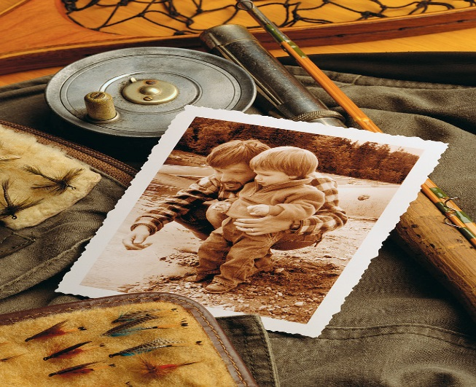




How Will They Remember Me?
Godly Fathers Need To Consider This Daily!

Slide 26

When They Open Their Bibles Let Them Remember Me As The One Who Taught Them About God’s Word
Godly Fathers Are A Blessing To Their Children

Slide 27

Reflections
Abortions
Neglecting
Abuse
Abandon
Killing
Selling
Why doesn't my mommy love me?
"I just want my mommy to love me!"

Slide 28
Quotes
“Being a full-time mother is one of the highest salaried jobs…since the payment is pure love.”--- Mildred B. Vermont
“All that I am or ever hope to be, I owe to my angel Mother.” --- Abraham Lincoln
“We never know the love of the parent until we become parents ourselves. --- Henry Ward Beecher

Slide 29
Quotes
“This heart, my own dear mother, bends, with love’s true instinct, back to thee.”--- Thomas Moore
“A mother is a person who seeing there are only four pieces of pie to give to five people, promptly announces she never did care for pie .” --- Tenneva Jordan
“Mama exhorted her children at every opportunity to “jump at de sun”. We might not land on the sun, but at least we would get off the ground.” --- Zora Neale Hurston

Slide 30
Godly Mothers Are Special
The Mother of Moses --- Exodus 2
Hannah the Mother of Samuel --- I Samuel 1 & 2
The Gentile Mother of Matthew 15:21-28
We Owe Godly Mothers So Much

Slide 31

GODLY MOTHERS ARE SPECIAL!
II Tim. 1:3-7; II Tim. 3:10-17
The Great Examples Of Lois And Eunice
As Recorded By Paul
Lois An
Example Of
A Godly
Grandmother
Eunice An
Example
Of A Godly
Mother

Slide 32

What Timothy Was Taught
“when I call to
remembrance the
genuine faith that
is in you,..”
“…and that from
childhood you have
known the Holy
Scriptures, which
are able to make you
wise for salvation
through faith which
is in Christ Jesus.”
To have genuine faith
Holy Scriptures will make one wise for salvation
Holy Scriptures given by inspiration of God
Holy Scriptures are profitable
Holy Scriptures make one complete, thoroughly equipped

Slide 33
Godly Mothers Are Special
"Her children rise up
and call her blessed."
Proverbs 31:28

Slide 34
Malachi 2:16
The Burden Of Making It Work!
“I can do all things through
Christ who strengthens me.”
In a changing world,
Eternal principles never change.

Slide 35
GOD'S PLAN FOR
YOUR SALVATION
Hear the Word of God--- Rom. 10:17
Believing In Your Heart--- Acts 16:31
Repenting Of Your Sins--- Acts 2:38
Confess Christ Is The Son of God- I John 4:15
Be Baptized Into Christ--- Gal. 3:26-29
Be Faithful Until Death--- Rev. 2:10; I Cor. 15:58
“Nevertheless let each one of you in particular
so love his own wife as himself, and let the wife see
that she respects her husband.”

