Slide 2
Bearing The Burdens Of Life
The Burden Of Ecclesiastes 3:1-8

Slide 3
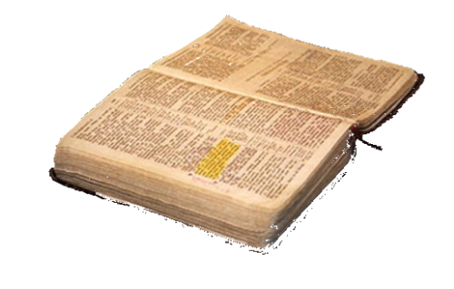
Religious AUTHORITY:
IS IT A BURDEN?
“…and has given Him authority to
execute judgment also, because
He is the Son of Man.”
JOHN 5:24-30

Slide 4
And whatever you do in word or deed, do all in the name of the Lord Jesus, giving thanks to God the Father through Him.
- Colossians 3:17
The Right to
Execute Power, Permission
Do All In The Name of The Lord . . .

Slide 5



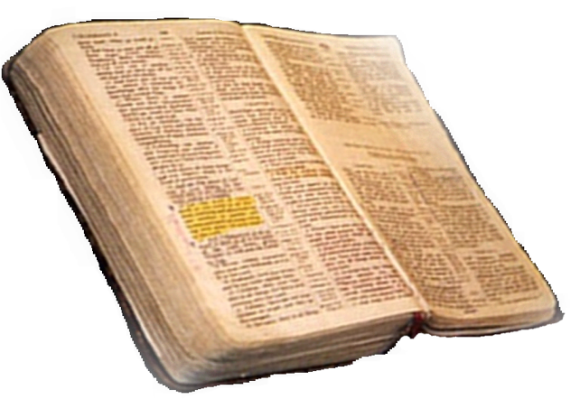
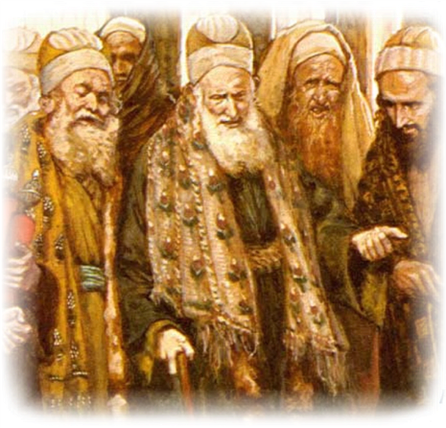





Only
Divine Is
Acceptable
  why do you transgress the commandment of God by your tradition?... in vain do they worship me...
  Matthew 15:3,9 - Colossians 2:20-23

Slide 6
“man has now come to the point where he feels that his own experience must be the final criterion by which all is to be judged.” He continues, “This is crucial. Even though a person may deviate only slightly from the orthodox doctrines of the faith, if he has shifted to another base of authority he has nonetheless taken a very tragic step which may lead him to further error.”
Authority: The Critical Issue
Dr. James T. Draper—a Southern Baptist
observes three competing claims for truth. These three possibilities are (1) human reasoning, (2) ecclesiastical authority, and (3) divine revelation.”

Slide 7

Our Parents (Mt. 10: 34-37)
Our Conscience (Acts 26:9-11)
The Majority (Mt. 7:13-14)
Religious Leaders (inc. elders) (2 Pet. 2:1-3; 1 Tim. 5:17-21)
Tradition (Col. 2:8)
Personal Desire (Pr. 14:12; Jer. 10:23)
Emotions & Feelings (Pr. 28:26)
Churches & Denominations (Acts 20:28-32; 1 Tim 4:1-3)
The Good End (Rom. 3:8)
Human Creeds (Mt. 15:7-9)

Slide 8

By Divine Design
God – Over All
Gen. 1:1; John 12:44-48,
I John 5:7 (NKJV)
For there are three that bear witness in heaven: the Father, the Word, and the Holy Spirit and these three are one.
Jesus Christ
Matt. 17:5; 28:18-20; 1 Cor. 15:27
Holy Spirit
John 16:13
Apostles –
Matt. 28:19,20; 1 Cor. 14:37
Hebrews 1:1-4

Slide 9
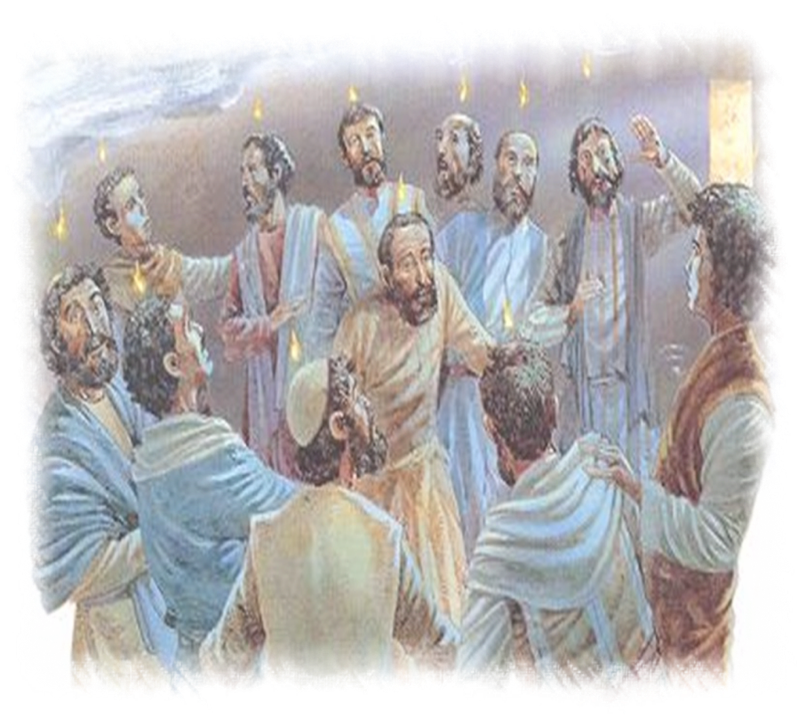
By Divine Design
Apostles –
Matt. 28:19,20;
1 Cor. 14:37;
1 John 4:6
“We are of God. He who knows God hears us; he who is not of God does not hear us. By this we know the spirit of truth and the spirit of error.”

Slide 10


All scripture
is given by
inspiration of God…
that the man of God
may be complete,
thoroughly equipped
for every good work.
2 Tim 3:16-17

Slide 11

The Inspired Pattern ( 2 Pet. 1:16-21)
The Complete Pattern (Jn. 14:26)
The Final Pattern (1 Pet. 1:22-25)
The Understandable Pattern ( 2 Tim. 3:15)
The Unalterable Pattern (Gal. 1:6-10)
The Saving Pattern (Rom. 1:16-17)
The Uniting Pattern (John 17:10,21)

Slide 12
The Pattern OF Truth...
is the
Sum
Total
Of What
God Has
Said
On The
Subject
The Plan of Salvation
The New Testament Church
How We Worship
The Day we Observe the Lord's Supper
Organization of the Church
Responsibilities of the Church
All that God has said about these things forms the pattern

Slide 13
The Apostle Paul Declared,...
2 Timothy 1:13
Hold fast the pattern of sound words which you have heard from me, in faith and love which are in Christ Jesus.

Slide 14

The Burden of Authority in Religion?
Do not preach ANOTHER GOSPEL (Gal. 1:6-10)
Do not teach a DIFFERENT DOCTRINE (1 Tim. 1:3-7)
Speak as the ORACLES OF GOD (1 Pet. 4:11)
Holding
to Apostolic
Tradition

Slide 15
The Burden of Authority in Religion?
Do all things ACCORDING TO THE PATTERN (2 Tim. 1:13)
Do not GO BEYOND
( 2 Jn. 9-11)
Do not ADD TO or TAKE FROM (II Thess. 2:15; Rev. 22:18-19)
Holding
to Apostolic
Tradition

Slide 16
GOD'S PLAN FOR
MAN'S SALVATION
"...and has given Him authority to execute judgment..."
Hear the Word of God---Rom. 10:17
Believing In Your Heart---Acts 16:31
Repenting Of Your Sins---Acts 2:38
Confess That Christ Is The Son of God--- I John 4:15
Be Baptized Into Christ---Gal. 3:26-29
Be Faithful Until Death---Rev. 2:10; I Cor. 15:58
Will Judgment Find You Following This Plan?

