Slide 2
Divisions
Within
The Church of Christ

Slide 3
During The Restoration Movement
Pointing men back to the Bible: “Where the Bible speaks, we speak; where it is silent, we are silent.”
Called for men to lay aside opinions and unite upon the Scriptures
Soon two major mindsets developed:
  Church can do only what is positively authorized
  Church can do anything not specifically forbidden
Division was inevitable!

Slide 4
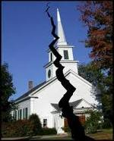
Churches of Christ Divided
In mid 1800s
Issues:
  Missionary Society (1849)
  Instrumental Music (1859)
Result:
  Formation of Christian Church (1900)
  Later: Disciples of Christ (liberal)

Slide 5
Churches of Christ Divided
In mid 1900s
Issues:
  Sponsoring Church (Hearld of Truth)
  Orphan Homes
  Colleges in Church Budget
  Social Gospel (Recreation)
Result:
  Split among churches 1955-1965
  Institutional churches of Christ

Slide 6
Value of Learning History
“History is a vast early warning system.” (Norman Cousins)
“Neither a wise man nor a brave man lies down on the tracks of history to wait for the train of the future to run over him.” (Dwight D. Eisenhower)
“Each time history repeats itself, the price goes up.” (Author Unknown)

Slide 7
The Missionary Society
History Behind It

Slide 8
History Behind It
Born out of desire to evangelize the world
  Great motive (Mark 16:15)
  Crying need in America & foreign soil
  Not enough was being done

Slide 9
History Behind It
Born out of desire to evangelize the world
Alexander Campbell - responsible

Slide 10
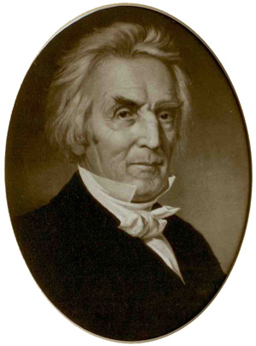
Alexander Campbell
1831 – Wrote a series in Millennial Harbinger – Argued that church can do what individual can’t, so a group of churches can do what a local church cannot
“A Church can do what an individual disciple cannot, and so can a district of churches do what a single congregation cannot.”
“The New Testament furnishes the principles which call forth our energies, but suggest no plan…”

Slide 11
Alexander Campbell
1831 – Wrote a series in Millennial Harbinger – Argued that church can do what individual can’t, so a group of churches can do what a local church cannot
Not much said for 10 years
1841 – Pushed stronger for an organization to help
“I am so deeply penetrated with the necessity of a more intimate organization, union and cooperation than at present existing among us, that I feel myself in duty bound again to invite the attention of the brotherhood…to a more thorough and profound consideration of the subject than they have ever given to it.”

Slide 12
Alexander Campbell
1831 – Wrote a series in Millennial Harbinger – Argued that church can do what individual can’t, so a group of churches can do what a local church cannot
Not much said for 10 years
1841 – Pushed stronger for an organization to help
Clear: Campbell wants brotherhood wide organizations through which churches may cooperate to preach the gospel.
1842 – 1848 wrote another series on “church organizations”

Slide 13
History Behind It
Born out of desire to evangelize the world
Alexander Campbell – responsible
First Missionary Society
  October 23, 1849 –
  Cincinnati, OH
  American Christian Missionary Society
  Campbell was first president

Slide 14
History Behind It
Born out of desire to evangelize the world
Alexander Campbell – responsible
First Missionary Society
Opposition from the conservatives
  Campbell had opposed such organizations in 1820’s –but changed!
  1855 - Gospel Advocate started

Slide 15
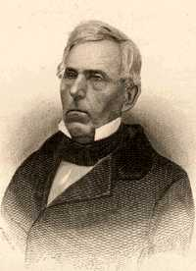
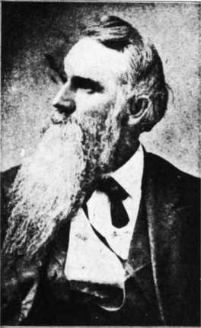
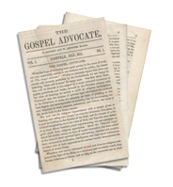
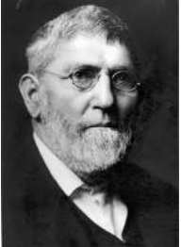
Objective: To oppose the Missionary Society
Gospel
Advocate
1855
Tolbert Fanning
William Lipscomb
David Lipscomb

Slide 16
The Missionary Society
History Behind It
What It Is

Slide 17
What It Is
Local
Church
$
Local
Church
Missionary
Society
$
Support
Preachers
$
Local
Church
$
A Separate Organization Between
The Church And The Work
Local
Church

Slide 18
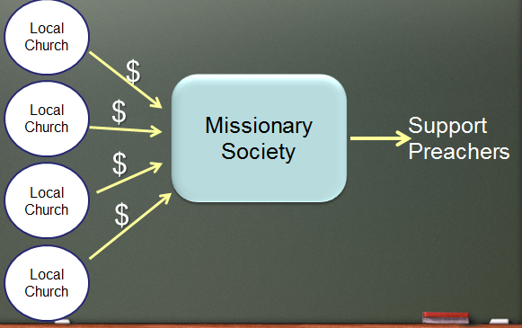
The Issue At Hand
Not: The preaching of the Gospel
Not: The churches responsibility to evangelize the world
Not: How little is being done
Not: How much good could be done by Missionary Society
IS: Where is the scripture for the organization between the church and the work being done?

Slide 19
Instrumental Music
History Behind It

Slide 20
History Behind It
Discussions about its use - early as 1849
  Articles in Christian Record – Favored use
  Articles in Ecclesiastical Reformer – Favored use

Slide 21
History Behind It
Discussions about its use - early as 1849
Campbell dismissed them as being for those who are not spiritually minded (1851)

Slide 22

Campbell Dismisses Plea for Instruments
“[Instrumental music in worship] was well adapted to churches founded on the Jewish pattern of things and practicing infant sprinkling. That all persons singing who have no spiritual discernment, taste or relish for spiritual meditation, consolations and sympathies of renewed hearts should call for such an aid is but natural. So to those who have no real devotion and spirituality in them, and whose animal nature flags under the opposition or the oppression of church service I think that instrumental music would... be an essential prerequisite to fire up their souls to even animal devotion. But I presume, that to all spiritually-minded Christians, such aid would be as a cow bell in a concert”
(Millennial Harbinger, Vol. I, No. 10; Robert Richardson, Memoirs of Alexander Campbell, 2:366).

Slide 23
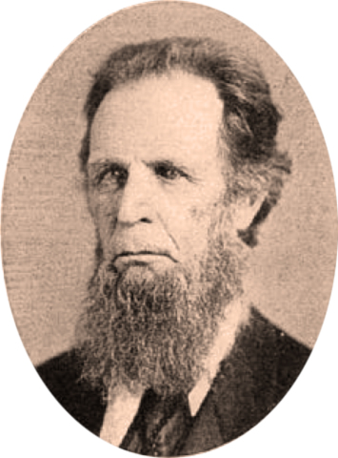
History Behind It
Discussions about its use - early as 1849
Campbell dismissed them as being for those who are not spiritually minded (1851)
Push for it in the church Millersburg, KY (1851)
Diary Entry (April 27, 1851): “Brother S (aunders) wishes to introduce the melodon into the church.”
Raines bitterly opposed it
Not used at Millersburg
Aylette Raines

Slide 24
History Behind It
Discussions about its use - early as 1849
Campbell dismissed them as being for those who are not spiritually minded (1851)
Push for it in the church Millersburg, KY (1851)
Sixth St. Church (Cincinnati) using it by 1855
(Everett Ferguson, Encyclopedia of the Stone-Campbell Movement, p. 414)

Slide 25
History Behind It
Discussions about its use - early as 1849
Campbell dismissed them as being for those who are not spiritually minded (1851)
Push for it in the church Millersburg, KY (1851)
Sixth St. Church (Cincinnati) using it by 1855
Introduced at Midway, KY 1859

Slide 26
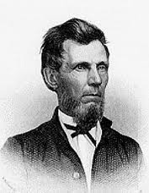
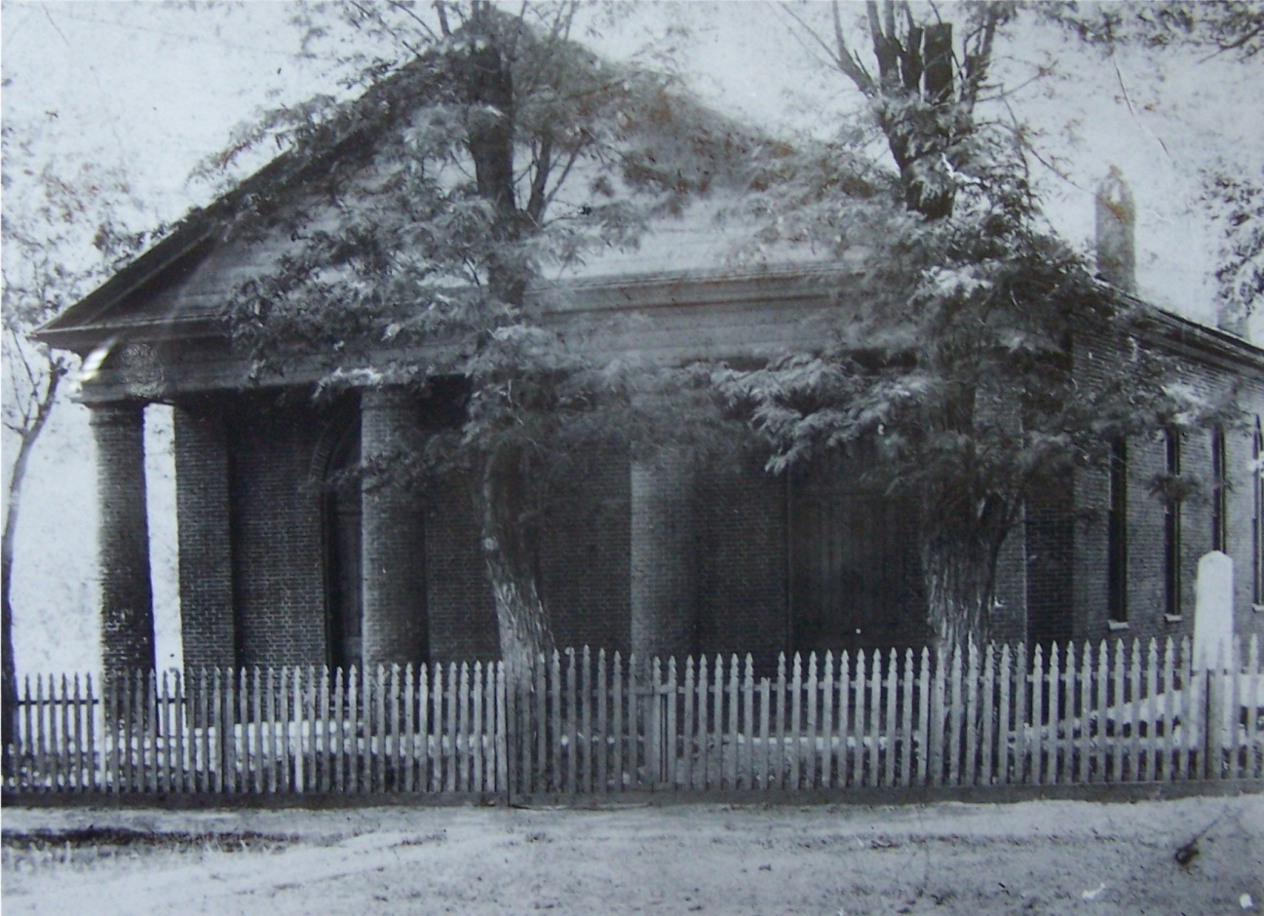
Instrument At Midway, KY 1859
L. L. Pinkerton

Slide 27
Instrument Introduced Slowly

Slide 28
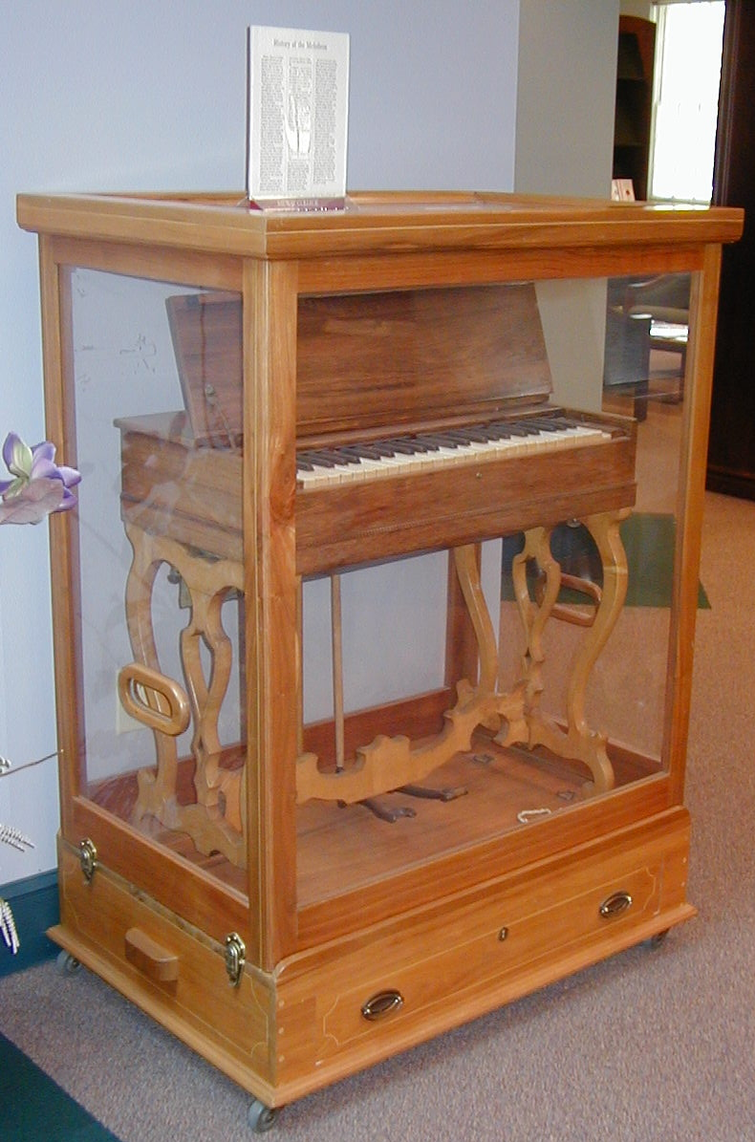
Adam Hibler (one of the elders) removed the melodeon & chopped it to pieces on front lawn
New one placed in bld.
Hibler removed the second – stored it in the barn.
A 3rd melodeon purchased
Building & melodeon burned
Second melodeon was found in Hibler’s barn

Slide 29
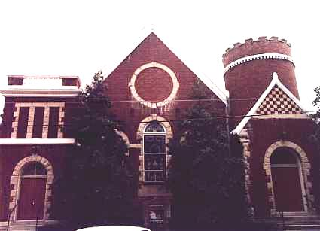
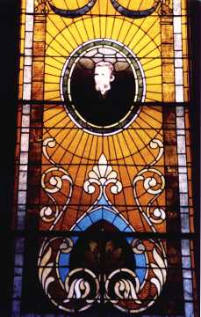
Midway Christian Church

Slide 30
History Behind It
Discussions about its use - early as 1849
Campbell dismissed them as being for those who are not spiritually minded (1851)
Push for it in the church Millersburg, KY (1851)
Sixth St. Church (Cincinnati) using it by 1855
Introduced at Midway, KY 1859
Reaction to the instrument being used

Slide 31
Reaction
Discussions / Debates
  J.W. McGarvey & A.S. Hayden in Millennial Harbinger (1864-1865)

Slide 32
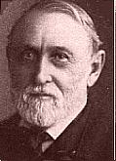
J. W. McGarvey on the Instrument
“We cannot, therefore, by any possibility, know that a certain element of worship is acceptable to God in the Christian dispensation, when the Scriptures which speak of that dispensation are silent in reference to it. To introduce any such element is unscriptural and presumptuous. It is will worship, if any such thing as will worship can exist. On this ground we condemn the burning of incense, the lighting of candles, the wearing of priestly robes, and the reading of printed prayers. On the same ground we condemn instrumental music” (The Millennial Harbinger, 1864, 511-513).

Slide 33
Reaction
Discussions / Debates
  J.W. McGarvey & A.S. Hayden in Millennial Harbinger (1864-1865)
  Gospel Advocate (David Lipscomb) opposed
  1908 – W.W. Otey & J.B. Briney (Louisville)
Middle of road view – for unity
  Christian Standard (Isaac Errett)
  McGarvey – taught against it – but fellowshipped those who used it.
Division – formed Christian Church
1911 – M.C. Kurfees – Book on Psallo

Slide 34
Church Support of Colleges
“Colleges Supported by Churches”
Was the first of the
“Institutional”
issues
Today Most Colleges
Among Brethren
Are Supported by Churches
David Lipscomb
Freed-Hardeman
Harding
Abilene Christian
Oklahoma Christian

Slide 35
Church Support of Colleges
History Behind It

Slide 36
History Behind It
Early Schools – had Some Church Support
  Kentucky Female Orphan School – L.L. Pinkerton (1849) – received some church support
  Fanning Orphan School – Tolbert Fanning (1884) – later received some church contributions
  But – Not Wide Spread

Slide 37
History Behind It
Early Schools – had Some Church Support
First Pleas from G.C. Brewer 1933, 35, 38

Slide 38
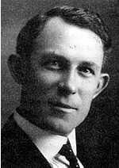
G. C. Brewer
1933 – Wrote a series of articles on “organizations” in Gospel Advocate. Said colleges had a right to exist & churches should support them.
1935 – Appealed for churches to put colleges & orphan homes in their budgets. Said churches Cleburne & Sherman, TX (where he preached) & two in OH had done so.
1938 – ACC Lectures urged elders to put ACC in budget: Said any church did not support the college had the wrong preacher!

Slide 39
History Behind It
Early Schools – had Some Church Support
First Pleas from G.C. Brewer 1933, 35, 38
Not Widespread Acceptance
  Most brethren did not agree
  The “College” was hard to sell (put in church budget)

Slide 40
History Behind It
Early Schools – had Some Church Support
First Pleas from G.C. Brewer 1933, 35, 38
Not Widespread Acceptance
1947 – Turning point
  ACC made a strong push for it
  N. B. Hardeman – turned the issue to orphan home

Slide 41
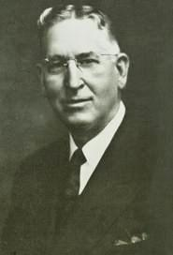
N. B. Hardeman
College
Supported
by Church
Orphan Home
Supported
by Church
Shifted to
“The right to contribute to one is the right to contribute to the other…The same principle that permits one permits the other. They must stand or fall together.”
(Gospel Advocate, 1947, p. 844)

Slide 42
Shifted to a “Sellable” Issue
College
Supported
by Church
Orphan Home
Supported
by Church
Shifted to
Has Emotion
Used as a tool to get college

Slide 43
History Behind It
Early Schools – had Some Church Support
First Pleas from G.C. Brewer 1933, 35, 38
Not Widespread Acceptance
1947 – Turning point
Opposition
  Bible Banner / Gospel Guardian (Wallace & Cogdill)
  Debated 1954 (W. L. Totty – Charles Holt)

Slide 44
History Behind It
Early Schools – had Some Church Support
First Pleas from G.C. Brewer 1933, 35, 38
Not Widespread Acceptance
1947 – Turning point
Opposition:
1963 – Batsell Barrett Baxter echoed Hardeman

Slide 45
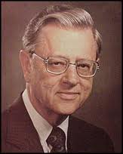
Batsell Barrett Baxter, Jr.
Question and Issues
Of the Day
In the Light of the Scriptures
Batsell Barrett Baxter
1963
“Some who are agreed that the church can contribute to an orphan’s home are not convinced that the church can contribute to a Christian school. It is difficult to see a significant difference so far as principle is concerned. The orphans’ home and Christian school must stand or fall together” (p. 29)

Slide 46
History Behind It
Early Schools – had Some Church Support
First Pleas from G.C. Brewer 1933, 35, 38
Not Widespread Acceptance
1947 – Turning point
Opposition:
1963 – Batsell Barrett Baxter echoed Hardeman
1968 – Athen Clay Pullias – wrote tract

Slide 47
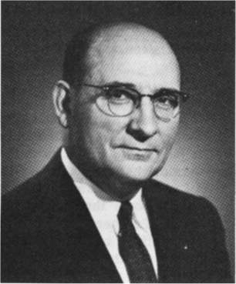
Athens Clay Pullias
1968
A Tract - Published by David Lipscomb College
Pushed for church support of the college

Slide 48




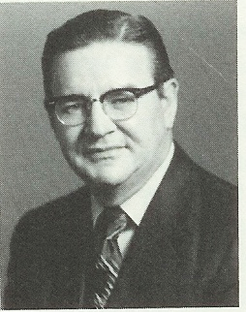
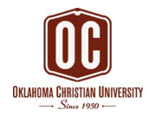

Colleges Accepting Church Contributions
Only One College
Did Not
James R. Cope
President
1949 - 1982
Board Meeting: Spring 1956
Cope being pressured said:
“My soul is not for sale, nor is this college.”
Notes:
FC 50-year book? They have a section on pp.74-75 that describes the series of board meetings (does not quote Cope's statementbut places it in spring 1956.

Slide 49
Problems With Church Support of Colleges
Issue Clarified
  Not: Do Bible colleges have a right to exist?
  Not: May individual Christians contribute to them?
  Not: The corruption in them or what is taught.
  IS: Do the Scriptures authorize churches to contribute to a Bible college?

Slide 50
The Missionary Society
Local
Church
$
Local
Church
Missionary
Society
$
Support
Preachers
$
Local
Church
$
A Separate Organization Between
The Church And The Work
Local
Church

Slide 51
The Bible College
Local
Church
$
Local
Church
“Christian
School” /
Bible College
$
Teach
Bible
$
Local
Church
$
A Separate Organization Between
The Church And The Work
Local
Church

Slide 52
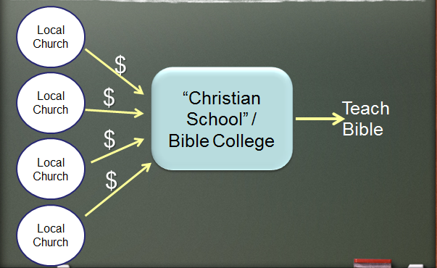
What is the Difference?
If one is Scriptural – so is the other!

Slide 53
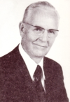
Roy E. Cogdill
1930’s & 1940’s
During / shortly after the “Premillennialism” controversy
Many churches (rejected the false doctrine)
Also didn’t tolerate the preaching against it
Not one of them stood – 50’s /60’s

Slide 54
Orphan Homes
Most noted of all the differences
Carried the most emotion
Most misunderstood of the issues

Slide 55
Orphan Homes
History Behind It

Slide 56
History Behind It
Orphan homes started long before real division
  Tennessee Orphan Home (Spring Hill, TN) – 1909
  Potter Orphan Home (Bowling Green, KY) – 1914
  Boles Home (Quinlan, TX) – 1924
  Southern Christian Home (Morrilton, AR) - 1926
  Tipton Home (Tipton, OK) - 1928

Slide 57
History Behind It
Orphan homes started long before real division
Opposition 30’s – 40’s
  Like other innovations – slow to catch on
  Sound brethren fought it as did in 1849-ff
  Guy N. Woods – Opposed it

Slide 58
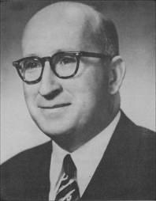
Guy N. Woods
"The ship of Zion has floundered more than once on the sandbar of institutionalism. The tendency to organize is a characteristic of the age. On the theory that the end justifies the means, brethren have now scrupled to form organizations in the church to do the work the church itself was designed to do. All such organizations usurp the work of the church, and are unnecessary and sinful"
(Abilene Christian College Lectures, 1939)

Slide 59
Guy N. Woods
"There is no place for charitable organizations in the work of the New Testament church. It is the only charitable organization that the Lord authorizes, or that is needed to do the work the Lord expects his people to do"
(The Annual Lesson Commentary for December 15, 1946)

Slide 60
History Behind It
Orphan homes started long before real division
Opposition 30’s – 40’s
Hardeman shifted the issue in 1947

Slide 61
N. B. Hardeman
College
Supported
by Church
Orphan Home
Supported
by Church
Shifted to
“The right to contribute to one is the right to contribute to the other…The same principle that permits one permits the other. They must stand or fall together.”
(Gospel Advocate, 1947, p. 844)

Slide 62
History Behind It
Orphan homes started long before real division
Opposition 30’s – 40’s
Hardeman shifted the issue in 1947
Debates
1954: Holt-Totty Debate (Indianapolis, IN)
1955: Harper-Tant Debate (Lufkin, TX) – April & November
1956: Porter-Woods Debate (Indianapolis, IN)
1957: Porter-Woods Debate (Paragould, AR)
1957:Cogdill-Woods Debate (Birmingham, AL)
1957: Porter-Deaver Debate (Dumas,TX)
1959: Wallace-Holt Debate (Florence, AL)
1961: Grider-Woods Debate (Louisville, KY)
1962: Sutton-Woods Debate (Peoria, IL)

Slide 63
History Behind It
Orphan homes started long before real division
Opposition 30’s – 40’s
Hardeman shifted the issue in 1947
Debates
Journals published on both sides

Slide 64
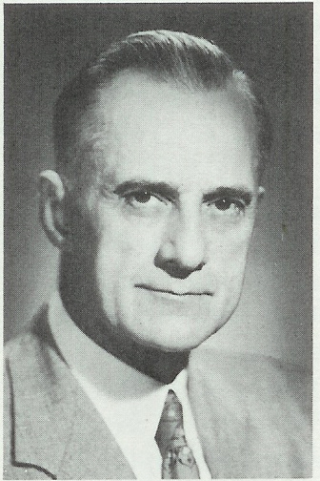
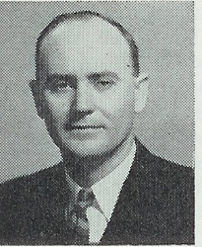
Journals – Favored Orphan Homes
Gospel Advocate
Firm Foundation
20th Century Christian
Christian Chronicle
B. C. Goodpasture
Gospel Advocate
Reuel Lemmons
Firm Foundation

Slide 65
Two Different Types of Orphan Homes
Under Elderships
Maude Carpenter
(Wichita, KS)
Tipton Orphan Home
(Tipton, OK)
Sunny Glenn
(San Benito, TX)
Lubbock Children's Home
(Lubbock, TX)
Under Board
Tennessee Orphan Home
(Spring Hill, TN)
Boles Home
(Quinlan, TX)
Potter Orphan Home
(Bowling Green, KY)
Child-Haven
(Cullman, AL)

Slide 66
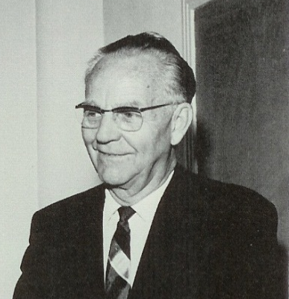
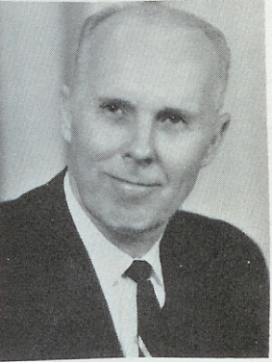


Journals – Opposed Orphan Homes
Gospel Guardian
Truth Magazine
Searching the Scriptures
Preceptor
Roy E. Cogdill
Gospel Guardian
Yater Tant
Gospel Guardian
H. E. Phillips
Searching the Scriptures
Cecil Willis
Truth Magazine

Slide 67
History Behind It
Orphan homes started long before real division
Opposition 30’s – 40’s
Hardeman shifted the issue in 1947
Debates
Journals published on both sides
Churches divided 1955-1965
  Historians estimate 80/20 split
  Usually small group pull off and start a new work
  Exceptions: Louisville, Athens, Tampa, Birmingham

Slide 68
History Behind It
Orphan homes started long before real division
Opposition 30’s – 40’s
Hardeman shifted the issue in 1947
Debates
Journals published on both sides
Churches divided 1955-1965
Things got ugly & bitter

Slide 69
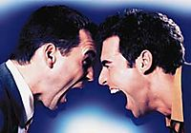
Things Got
Ugly & Bitter
Yellow Tag Of Quarantine – B.C. Goodpasture, Gospel Advocate 1954
Robert Jackson – knife pulled on him (Taylor Blvd)
Rufus Clifford – spat upon
Ads: “No Anti need apply”
Charges: “Orphan haters” / “Let orphan starve…”
Some “locked out” of buildings where were members

Slide 70
So… Who really left what?
“The mainstream churches of Christ, time and again, characterized those who opposed institutionalism as unfaithful to the heritage. The truth is that the dissenters stood squarely in one set of the footprints in the 19th century churches of Christ. And by the time the battle over institutions was complete, it was the mainstream, not the dissenters, that had removed itself almost entirely from its 19th century roots.”
Reviving the Ancient Faith
Richard Hughes, Pepperdine University

Slide 71
Orphan Homes
History Behind It
The Issue

Slide 72
The Issue
Is Not:
Should the needy be cared for?
Is the church obligated?
A matter of how (modes, means, methods)
Systematic arrangement
A matter of a “place” being maintained
Is:
Can churches build and maintain benevolent organizations through which to do their work?
A matter of a separate organization doing the work of the church

Slide 73
Problems With Support of Orphan Homes
No Authority
Parallel to the Missionary Society

Slide 74
The Missionary Society
Local
Church
$
Local
Church
Missionary
Society
$
Support
Preachers
$
Local
Church
$
A Separate Organization Between
The Church And The Work
Local
Church

Slide 75
The Benevolent Society
Local
Church
$
Local
Church
Benevolent
Society
“Orphan Home”
$
Care of
Needy
$
Local
Church
$
A Separate Organization Between
The Church And The Work
Local
Church

