Slide 1
2SAM.12:1-7
Then the Lord sent Nathan to David. And he came to him, and said to him: “There were two men in one city, one rich and the other poor. 2 The rich man had exceedingly many flocks and herds. 3 But the poor man had nothing, except one little ewe lamb which he had bought and nourished; and it grew up together with him and with his children. It ate of his own food and drank from his own cup and lay in his bosom; and it was like a daughter to him 4. And a

Slide 2
traveler came to the rich man, who refused to take from his own flock and from his own herd to prepare one for the wayfaring man who had come to him; but he took the poor man’s lamb and prepared it for the man who had come to him. David burned with anger against the man and said to Nathan, “As surely as the Lord lives, the man who did this must die! 6 He must pay for that lamb four times over, because he did such a thing and had no pity.” 7 Then Nathan said to David, “You are the man!”

Slide 3
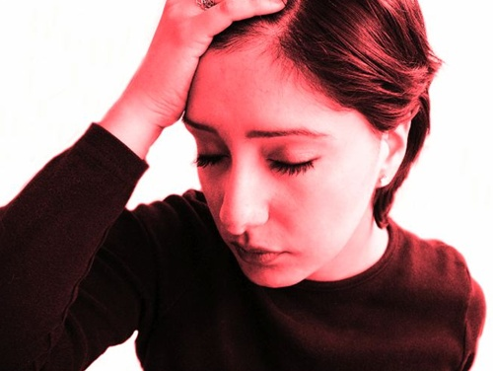
THE MORNING AFTER

Slide 4
THE MORNING AFTER FOR:
ADAM AND EVE – GEN.3:9-13
Then the Lord God called to Adam and said to him, “Where are you?” 10 So he said, “I heard Your voice in the garden, and I was afraid because I was naked; and I hid myself.” 11 And He said, “Who told you that you were naked? Have you eaten from the tree of which I commanded you that you should not eat?”12 Then the man said, “The woman whom You gave to be with me, she gave me of the tree, and I ate.”13 And the Lord God said to the woman, “What is this you have done?” The woman said, “The serpent deceived me, and I ate.”

Slide 5
THE MORNING AFTER FOR:
CAIN – GEN.4:5-13
but He did not respect Cain and his offer-ing. And Cain was very angry, and his countenance fell. 6 So the Lord said to Cain, “Why are you angry? And why has your countenance fallen? 7 If you do well will you not be accepted? And if you do not do well, sin lies at the door. And its desire is for you, but you should rule over it.” 8 Now

Slide 6
Cain talked with Abel his brother; and it came to pass, when they were in the field, that Cain rose up against Abel his brother and killed him. 9 Then the Lord said to Cain, “Where is Abel your brother?” He said, “I do not know. Am I my brother’s keeper?” 10 And He said, “What have you done? The voice of your brother’s blood cries out to Me from the ground. 11 So now

Slide 7
you are cursed from the earth, which has opened its mouth to receive your brother’s blood from your hand. 12 When you till the ground, it shall no longer yield its strength to you. A fugitive and a vagabond you shall be on the earth.” 13 And Cain said to the Lord, “My punishment is greater than I can bear!

Slide 8
THE MORNING AFTER FOR:
DAVID – 2SAM.12:1ff
Then the Lord sent Nathan to David. And he came to him, and said to him: “There were two men in one city, one rich and the other poor. 2 The rich man had exceedingly many flocks and herds. 3 But the poor man had nothing, except one little ewe lamb which he had bought and nourished; and it grew up together with him and with his

Slide 9
children. It ate of his own food and drank from his own cup and lay in his bosom; and it was like a daughter to him. 4 And a traveler came to the rich man, who refused to take from his own flock and from his own herd to prepare one for the wayfaring man who had come to him; but he took the poor man’s lamb and prepared it for the man who had come to him.” 5 So David’s anger was greatly aroused against the man,

Slide 10
and he said to Nathan, “As the Lord lives, the man who has done this shall surely die! 6 And he shall restore fourfold for the lamb, because he did this thing and because he had no pity.” 7 Then Nathan said to David, “You are the man!

Slide 11
THE MORNING AFTER FOR:
PHAROAH – EX.12:30
So Pharaoh rose in the night, he, all his servants, and all the Egyptians; and there was a great cry in Egypt, for there was not a house where there was not one dead.

Slide 12
THE MORNING AFTER FOR:
ACHAN – JOSH.7:20-21
And Achan answered Joshua and said, “In-deed I have sinned against the Lord God of Israel, and this is what I have done: 21 When I saw among the spoils a beautiful Babylonian garment, two hundred shekels of silver, and a wedge of gold weighing fifty shekels, I cov-eted them and took them. And there they are, hidden in the earth in the midst of my tent, with the silver under it.”

Slide 13
THE MORNING AFTER FOR:
JUDAS – MT.27:1-5
When morning came, all the chief priests and elders of the people plotted against Jesus to put Him to death. 2 And when they had bound Him, they led Him away and delivered Him to Pontius Pilate the gov-ernor. 3 Then Judas, His betrayer, seeing that He had been condemned, was re-morseful and brought back the thirty pieces of silver to the chief priests and elders, 4

Slide 14
saying, “I have sinned by betraying innocent blood.” And they said, “What is that to us? You see to it!” 5 Then he threw down the pieces of silver in the temple and departed, and went and hanged himself.

Slide 15
MOSES’ MORNING AFTER – HEB.11:24ff
REJECTED EARTHLY JOY
MADE WISE CHOICES
RIGHT IDEA ABOUT RICHES
SEPARATED LIFE
FEARED GOD
PERSERVERED

Slide 17
PREACHED:
PC. – 3-11-18 SN
Columbus ST. Cleve, OH. 4-15-18 SN
Olinda, TN. Near Franklin, KY. 4-27-18 Fr
Belleville, IN. 9-9-18 SM

