Slide 1
ACTS 19:8-9
Paul entered the synagogue and spoke boldly there for three months, arguing persuasively about the kingdom of God. 9 But some of them became obstinate; they refused to believe and publicly maligned the Way. So Paul left them. He took the disciples with him and had discussions daily in the lecture hall of Tyrannus.

Slide 2
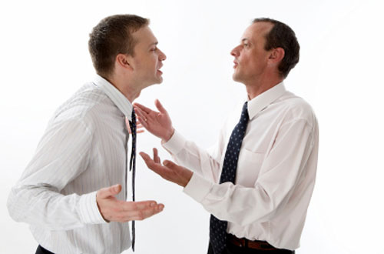
IS IT WRONG TO DISPUTE RELIGIOUS? ERROR?

Slide 3
COMMANDED TO PROVE ALL THIINGS
1Thess.5:21 Test all things; hold fast what is good
1Jn.4:1 Dear friends, do not believe every spirit, but test the spirits to see whether they are from God, because many false prophets have gone out into the world.
Lk.8:18 - Take heed how ye hear
Mk.4:24 - Take heed what ye hear
2Cor.13:5 Examine yourselves as to whether you are in the faith. - Test yourselves.

Slide 4
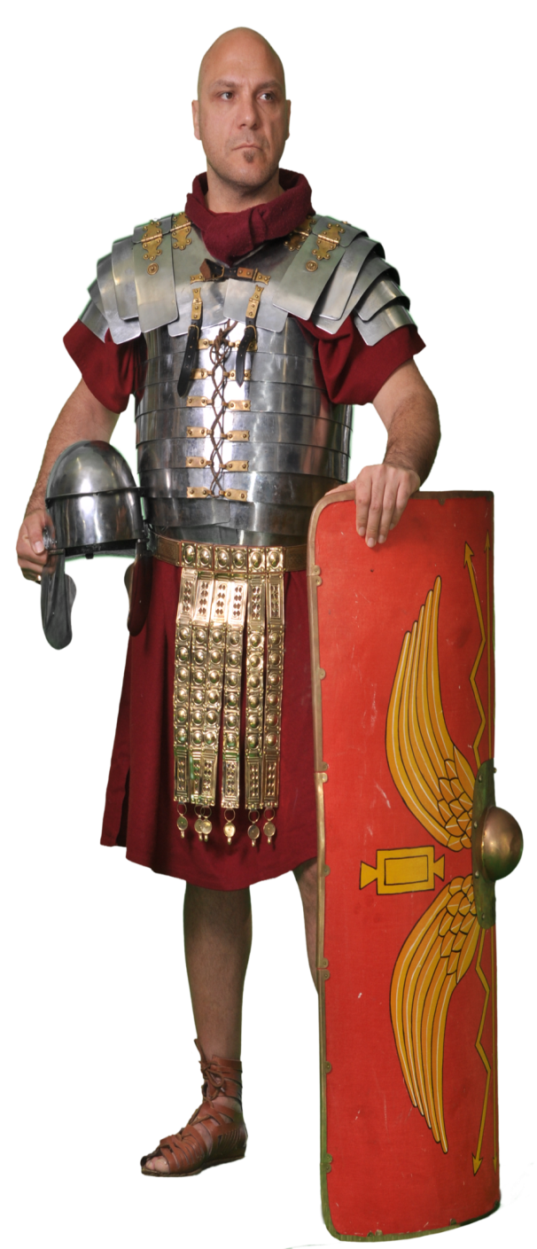
Remember all the references to “soldiers” and the military terms in the N.T.
WE MUST MAKE A STAND
Eph.6:10-17- armor of God – Heb.4:12 - sword
2Cor.10:3-4 – weapons of our warfare
1Tim.6:12 – fight the good fight
1:18 – war a good warfare
2Tim.2:3-4 – endure hardness

Slide 5
The songs we sing:
“Soldiers of Christ Arise”
“Faith is the Victory”
“We Shall See The King Some Day”
“The Fight Is On”
“Onward Christian Soldiers”
“I’m in the Lord’s Army” (Children’s Song)

Slide 6
JESUS DESCRIBES FALSE TEACHERS
Named them: Scribes, Pharisees -Mt.7:15 –23:1-39
Wolves in sheep's clothing
Whited sepulchers
Sons of hell, snakes
Fools and blind
Blind guides, hypocrites
Beware of their leaven (Permeates) Mt.16:6, 1Cor.5

Slide 7
The Lord renounced and repudiated the doctrines and commandments of his Jewish brethren
Mt.15:1-9, 12 – “In vain they do worship me…offended”
Mt.21:29-46; 23:2-33.
Was he guilty of “slandering and putting down someone’s religion?”

Slide 8
The Lord severely rebuked several of the seven churches of Asia, saying
They had left their first love, that they were
“wretched, and miserable, and poor, and blind, and naked.”
He told the church at Sardis that they were “dead” Rev.2:2-5; 3:1, 17.
Was Jesus guilty of “slandering and putting down someone’s religion?”

Slide 9
MOTIVATION TO GET IN THE BATTLE
Which denomination tells people what to do to be saved?
Catholicism?–Sprinkle infants, Pope “Vicar of Christ”
Baptists? – “Accept Jesus as personal Savior”
Mormonism? - “Another testament” - Joseph Smith
Jehovah Witness – Faith only, Baptism unnecessary

Slide 10
MOTIVATION TO GET IN THE BATTLE
Remember Elijah – 1Kg.18:27
Elijah against 450 prophets of Baal
At noon Elijah began to taunt them. “Shout louder!” he said. “Surely he is a god! Perhaps he is deep in thought, or busy, or traveling. Maybe he is sleeping and must be awakened.”
Taunt = a remark made in order to anger, wound, or provoke someone.

Slide 11
Listen to God’s admonition to Jeremiah
Jer.1:9 …and the Lord said to me: “Behold, I have put My words in your mouth. 10 See, I have this day set you over the nations and over the kingdoms, To root out and to pull down, To destroy and to throw down, To build and to plant.”

Slide 12
Jer.1:17-19
“Therefore prepare yourself and arise, And speak to them all that I command you. Do not be dismayed before their faces, Lest I dismay you before them. 18 For behold, I have made you this day a fortified city and an iron pillar, And bronze walls against the whole land— Against the kings of Judah, Against its princes, Against its priests, And against the people of the land. 19 They will fight against you, But they shall not prevail against you. For I am with you,” says the Lord, “to deliver you.”

Slide 13
Eph.6:10 Finally, be strong in the Lord and in his mighty power. 11 Put on the full armor of God, so that you can take your stand against the devil’s schemes. 12 For our struggle is not against flesh and blood, but against the rulers, against the authorities, against the powers of this dark world and against the spiritual forces of evil in the heavenly realms.

Slide 14
Weapons and Armor are for Soldiers
2Cor.10:3 For though we walk in the flesh, we do not war according to the flesh. 4 For the weapons of our warfare are not carnal but mighty in God for pulling down strongholds

Slide 15
1Tim.1:18 Timothy, my son, I am giving you this command in keeping with the prophecies once made about you, so that by recalling them you may fight the battle well…
1Tim.6:12 Fight the good fight of the faith. Take hold of the eternal life to which you were called when you made your good confession in the presence of many witnesses.

Slide 16
2Tim.2:3 Join with me in suffering, like a good soldier of Christ Jesus. 4 No one serving as a soldier gets entangled in civilian affairs, but rather tries to please his commanding officer.
2Tim.3:12 All that live godly in Christ Jesus shall suffer persecution
Paul did. 2Cor.11:22ff
Acts 5:41 So they departed from the presence of the council, rejoicing that they were counted worthy to suffer shame for His name.
1Pt.4:16 If any man suffer as a Christian, let him not be ashamed; but let him God in this name.

Slide 17
WE ARE IN FOR THE FIGHT OF OUR LIFE
CONSIDER THIS LESSON AS A
“BOOT CAMP”
Are we “set for the defense of the gospel”? Phil.1:17
Can we “earnestly contend for the faith”? Jude 3
Are we ready to give an answer? 1Pt.3:15
False teachers lead souls to torment! Mt.15:14

Slide 18
Results of some Bible discussions
Acts 9:22 Saul increased the more in strength, and confounded the Jews which dwelt at Damascus, proving that this is very Christ“
23 Now after many days were past, the Jews plotted to kill him. 24 But their plot became known to Saul. And they watched the gates day and night, to kill him.
29 He talked and debated with the Hellenistic Jews, but they tried to kill him.

Slide 19
Paul’s Preaching:
Acts 17:2 As was his custom, Paul went into the synagogue, and on three Sabbath days he reasoned with them from the Scriptures, 3 explaining and proving that the Messiah had to suffer and rise from the dead. “This Jesus I am proclaiming to you is the Messiah,”

Slide 20
Results: Positive - Negative
17:4 And some of them were persuaded; and a great multitude of the devout Greeks, and not a few of the leading women, joined Paul and Silas.
5. But the Jews who were not persuaded, becoming envious, took some of the evil men from the market-place, and gathering a mob, set all the city in an uproar and attacked the house of Jason, and sought to bring them out to the people.

Slide 21
Results: Positive - Negative
Acts 17:11 These were more fair-minded than those in Thessalonica, in that they received the word with all readiness, and searched the Scriptures daily to find out whether these things were so. 12 Therefore many of them believed, and also not a few of the Greeks, prominent women as well as men.
13 But when the Jews from Thessalonica learned that the word of God was preached by Paul at Berea, they came there also and stirred up the crowds.

Slide 22
Negative Results of Bible discussions
v.17 Therefore he disputed in the synagogue with the Jews, and with the devout persons, and in the market-place daily with those who met with him. 18 Then certain Epicurean and Stoic philosophers encountered him. And some said, “What does this babbler want to say?”
v.32 And when they heard of the resurrection of the dead, some mocked…”
Today: “When they heard of baptism some mocked”
SOUND FAMILIAR?

Slide 23
Our Problem - Matthew 9:37
The harvest truly is plentiful, but the laborers are few.
Do you think we won’t receive the same treatment? Mt.10:25
It’s not your fault if they don’t believe.
It is our fault if we don’t “Go”

Slide 24
How Paul Dealt With False Teachers
1. Elymas
Acts 13:9-11 Then Saul, (who also is called Paul,) filled with the Holy Ghost, set his eyes on him, and said, O full of all subtlety and all mischief, thou child of the devil, thou enemy of all righteous-ness, wilt thou not cease to pervert the right ways of the Lord?

Slide 25
2. The controversy over circumcision and keeping the Law of Moses
Gal.2:5 to whom we did not yield submission even for an hour, that the truth of the gospel might continue with you.
NO COMPROMISING!
Do we sin when we do not submit to the False Teacher?
Shall we bid them “God speed”? 2Jn.9-11
Shall we compromise?
Are we the problem?

Slide 26
3. The Judaizers at Galatia
Gal.1:8 But even if we, or an angel from heaven, preach any other gospel to you than what we have preached to you, let him be accursed. 9 As we have said before, so now I say again, if anyone preaches any other gospel to you than what you have received, let him be accursed.

Slide 27
5. The Judaizers at Philippi
Phil.3:2 “Beware of dogs, beware of evil workers, beware of the concision”
3:18-19 For many walk, of whom I have told you often, and now tell you even weeping, that they are the enemies of the cross of Christ: Whose end is destruc-tion, whose God is their belly, and whose glory is in their shame, who mind earthly things.

Slide 28
6. The Gnostics at Colossae
Col.2:8 Beware lest any man spoil you through philosophy and vain deceit, after the tradition of men, after the rudiments of the world, and not after Christ.

Slide 29
7. Paul’s Instructions to Timothy
1Tim.1:3 As I urged you when I went into Macedonia—remain in Ephesus that you may charge some that they teach no other doctrine, 4 nor give heed to fables and endless genealogies, which cause disputes rather than godly edification which is in faith.

Slide 30
7. Paul’s Instructions to Timothy
1Tim.1:19 having faith and a good conscience, which some having rejected, concerning the faith have suffered shipwreck, 20 of whom are Hymenaeus and Alexander, whom I delivered to Satan that they may learn not to blaspheme.

Slide 31
7. Paul’s Instructions to Timothy
1Tim.6:3 If anyone teaches otherwise and does not consent to wholesome words, even the words of our Lord Jesus Christ, and to the doctrine which accords with godliness, 4 he is proud, knowing nothing, but is obsessed with disputes and arguments over words, from which come envy, strife, reviling, evil suspi-cions, 5 useless wranglings of men of corrupt minds and destitute of the truth, who suppose that godli-ness is a means of gain. From such withdraw yourself.

Slide 32
7. Paul’s Instructions to Timothy
2Tim.1:15 This you know, that all those in Asia have turned away from me, among whom are Phygellus and Hermogenes.
2:16 But shun profane and idle babblings, for they will increase to more ungodliness. 17 And their message will spread like cancer. Hymenaeus and Philetus are of this sort, 18 who have strayed concerning the truth, saying that the resurrection is already past; and they overthrow the faith of some.

Slide 33
What conclusions can we draw:
a. All have the responsibility to resist false
b. False doctrines of men need to be addressed specifically and directly.
c. The false teachers need to be directly confronted, exposed by name.
d. One is not guilty of sin when resisting false teachers and false teaching

Slide 34
Rm.16:17 Now I urge you, brethren, note those who cause divisions and offenses, contrary to the doctrine which you learned, and avoid them
Holy Spirit commanded us to “mark" those false teachers who cause divisions and occasions of stumbling and "avoid" (KJV) them

Slide 35
Our word "mark" means:
"a mark on which to fix the eye, to look at;" "to observe attentively and diligently (Like a snake – mh), as they do who are placed in a watchtower to observe the motions of their enemies" (W.E. Vine, James MacKnight).
We need to let false teachers know that we are not afraid and that we are here to stay.

Slide 36
1. Should we leave the lost alone, don’t cause a stir, or be on the attack?
What is the value of one soul? Mk.8:36-37
Pro.28:4 They that forsake the law praise the wicked: but such as keep the law contend with them.

Slide 37
Edmund Burke:
“The only thing necessary for the triumph of evil is for good men to do nothing.”
Jude 3 Dear friends, although I was very eager to write to you about the salvation we share, I felt compelled to write and urge you to contend for the faith that was once for all entrusted to God’s holy people.

Slide 38
How are we to act?
Phil.1:27 Whatever happens, conduct yourselves in a manner worthy of the gospel of Christ. Then, whether I come and see you or only hear about you in my absence, I will know that you stand firm in one spirit, contending as one man for the faith of the gospel
1Pet.2:12 having your conduct honorable among the Gentiles, that when they speak against you as evildoers, they may, by your good works which they observe, glorify God in the day of visitation.

Slide 39
Baptist Pastor Mel Dibble:
“Leave us alone, we leave you alone”
Shall we become PC?
Shall we keep quiet?

Slide 40
Question for Danville Calvary Baptist church
"Do you believe baptism is necessary for salvation?“
Their answer:
Hi Morris,
Thank you for contacting Calvary Chapel.
"We appreciate your question and hope you are able to find a good answer."

Slide 41
Calvary Chapel is not a denomination and therefore does not corporately take positions on things other than doctrine and a few philosophy of ministry principles. You can see our doctrinal statement of faith here: Thanks for contacting us and God bless,
Blessings,
CalvaryChapel.com

Slide 42
MY RESPONSE:
Yesterday I asked a simple question, "Do you believe baptism is necessary for salvation" and asked the reasons for your belief. You said you hoped I would be able to find a good answer. The apostle Peter said to "be ready always to give an answer to every man that asketh you a reason of the hope that is in you with meekness and fear." 1Pet.3:15
We may differ in our answer. If so, both of us could be wrong, but both of us cannot be right. Surely you have some idea what you believe. Just give Scripture Col.3:17.

Slide 43
2. What would be a wrong reason for contending for the faith?
  a. Fame
  b. Finance
  c. Put someone down

Slide 44
3. What does 1Pet.3:15 tell us to be ready to do?
  But sanctify the Lord God in your hearts: and be ready always to give an answer to every man that asketh you a reason of the hope that is in you with meekness and fear.
  Be ready – prepared
  To give an answer – make an argument
    How does that happen? – 2Tim.2:15 -Psm.119:11

Slide 45
  b. Col.4:6 Let your speech always be with grace, as though seasoned with salt, so that you will know how you should respond to each person.
  1. Respond = give an answer, make an argument
  2. Phil.1:17b I am set for the defense of the gospel

Slide 46
4. What did Aquila and Priscilla do when they heard that Apollos only knew the baptism of John?
Acts 18:24-26
They made fun of him and shamed him in front of all the people
b. They talked about how “ignert” he was for still believing in John’s baptism
They took him unto them, and expounded the word of God more perfectly

Slide 47
5. What is inferred about Apollos reception of their teaching – vs.27-28
He stomped off mad
He told everyone about the nerve of Priscilla and Aquila, “Don’t they know I’m an eloquent preacher, and mighty in the scriptures”
He graciously accepted their teaching

Slide 48
6. When studying with those in error what must be our attitude Eph.4:15
Speak (method) the truth (message) in love (manner)
b. 2Tim.4:2 Preach the word; be instant in season, out of season; reprove, rebuke, exhort with all longsuffering and doctrine. Cf. Eph.4:1-3
c. Jer.1:10. See I have this day set thee over the nations and over the kingdoms to root out, and to pull down, and to destroy, and to throw down, to build and to plant.

Slide 49
7. Do conversions always occur at the first Bible study?
Acts 17:4-5, 12-13
Jn.6:66

Slide 50
“THIS IS A WARNING…”
1Cor.4:6 Do not go beyond what is written
Dt.4:2 Do not add to what I command you and do not subtract from it, but keep the commands of the Lord your God that I give you.
Pro.30:6 Add thou not to his words, lest he reprove thee, and thou be found a liar.
2Jn.9 Whosoever transgresseth…

Slide 51
“THIS IS A WARNING…”
Deut. 5:32 Ye shall observe to do therefore as the Lord your God hath commanded you: ye shall not turn aside to the right hand or to the left”
Deut. 28:14 And thou shalt not go aside from any of the words which I command thee this day, to the right hand, or to the left
Rev.22:18-19 – Don’t add to or take from
Are these just suggestions from God?

Slide 53
Preached:
Winding Rd. 3-30-15 Tues.
Murfreesboro, TN. 10-29-17 SN
Hartshorn Ridge, OH. 11-9-17 Thur
Belleville, IN. 9-11-18 – Tue.

