Slide 1
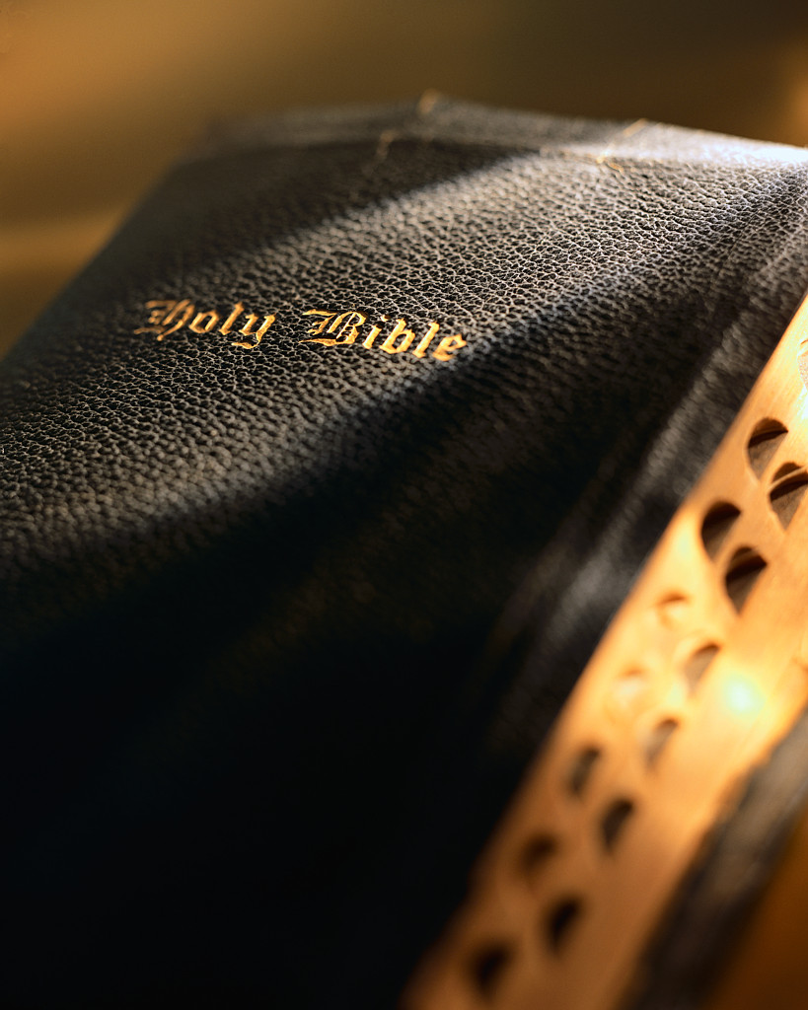

Slide 2
“I Believe God That It Will Be Just As It Was Told Me”
Acts 27:25

Slide 3
I Believe God That It Will Be Just As It Was Told Me
There Is Only One Way To Life
Goodness Alone Will Not Save
One Cannot Be Saved By Faith Alone
Baptism Saves Us
Jesus Will Return
The Unrighteous Will Be Lost
The Righteous Will Have Eternal Life

Slide 4
God’s Plan
For Saving Man
Hear the Word – Matt. 17:5
Believe in the Lord – Jn. 8:24
Repent of Your Sins – Ac. 17:30
Confess Your Faith – Matt. 10:32
Be Baptized – Mk. 16:16
Remain Faithful – 1 Cor. 15:58

