Slide 1
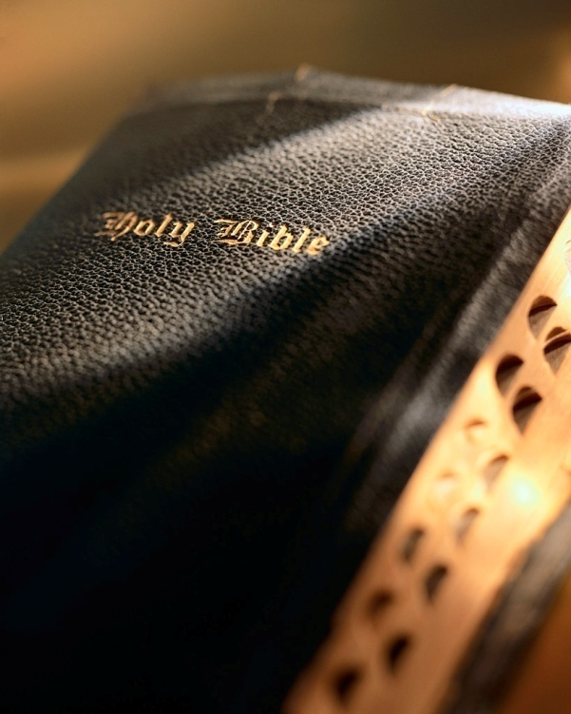

Slide 2
?
God Said Nothing

Slide 3
God Said Nothing
Salvation By Faith Only
Salvation By Sinner’s Prayer
Sprinkling Or Pouring For Baptism
Once Saved, Always Saved
Attend The Church Of Your Choice
?

Slide 4
God’s Plan For
Saving Man
Hear the Word – Matt. 17:5
Believe in the Lord – Jn. 8:24
Repent of Your Sins – Ac. 17:30
Confess Your Faith – Matt. 10:32
Be Baptized – Mk. 16:16
Remain Faithful – 1 Cor. 15:58

