Slide 1
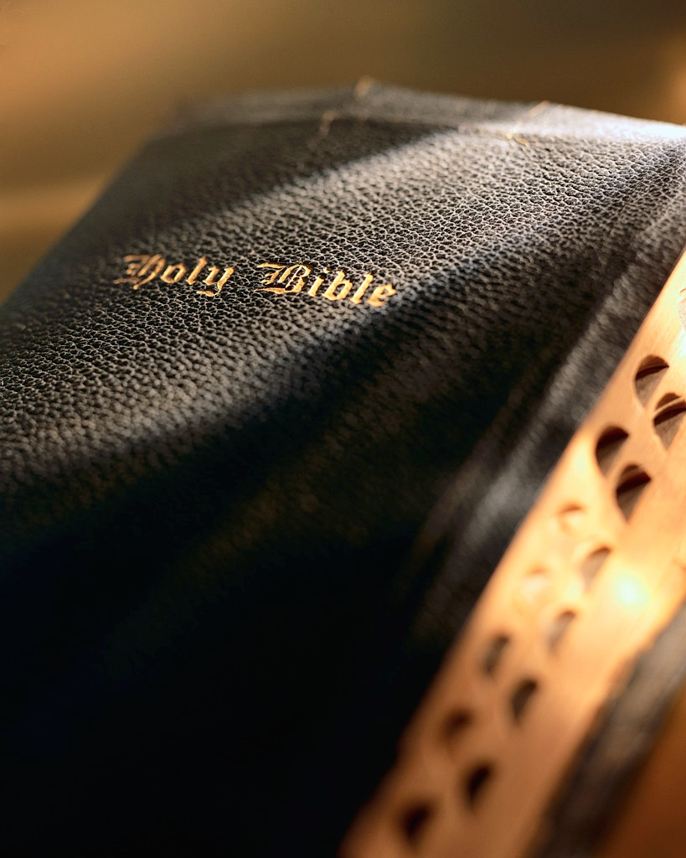

Slide 2
Do Not Say

Slide 3
Do Not Say
I Will Recompense Evil
This Building Is The Church
I’m Church Of Christ
One Church Is Good As Another
Other Denominations
Reverend, Father, Or Pastor
Baptism Is Not Necessary

Slide 4
God’s Plan For Saving Man
Hear the Word – Matt. 17:5
Believe in the Lord – Jn. 8:24
Repent of Your Sins – Ac. 17:30
Confess Your Faith – Matt. 10:32
Be Baptized – Mk. 16:16
Remain Faithful – 1 Cor. 15:58

